Slide 1
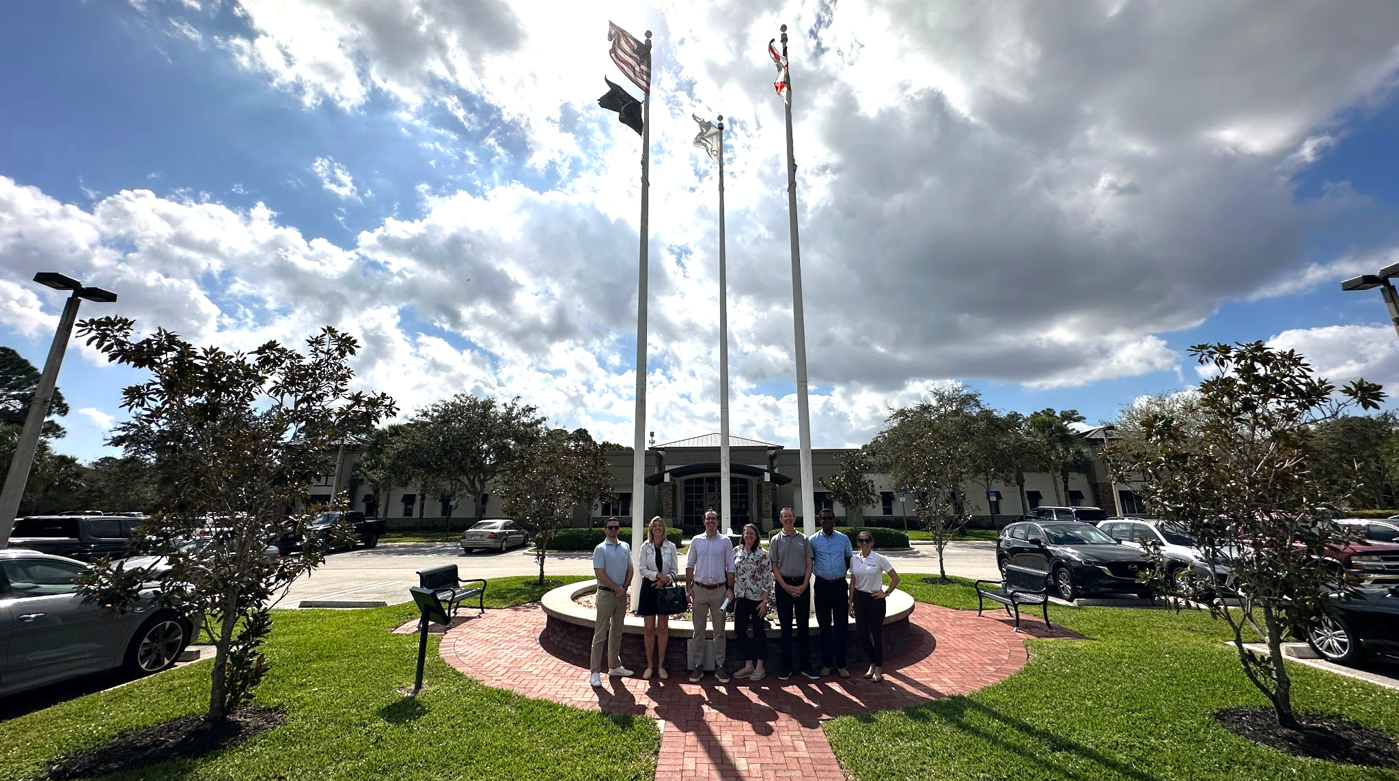


CITY OF GREENACRES
VISION
FOR
A
DOWNTOWN
“A Good Place to Live”

Slide 2
City of Greenacres: Vision for a Downtown
AGENDA
Overview
Greenacres ULI Team
Goals
Background Research
Site Selection
Recommendations
Notes:
It's great to see you again since our last meeting in February. Over the past few months, we've been working diligently to compile our recommendations, and we're excited to present them to you today.
We have prepared a presentation for you based on the report you have on hand
Our team was tasked with establishing a new downtown for the City of Greenacres through strategic land-use and policy changes to boost local economy
Despite being easily accessible, centrally located, and ranking among the most desirable ZIP codes for homebuyers in South Florida, Greenacres faces the challenge of often being overlooked as a destination for visitors and businesses.
We are going to walk you through the project Goals, Background research, Site selection, and recommendations
We welcome your questions and discussion during the presentation, so please feel free to stop us at any time

Slide 3
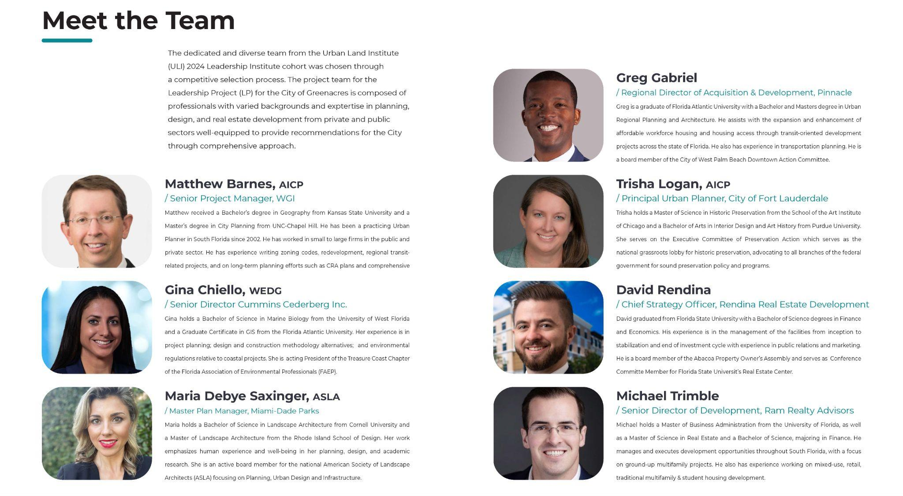
Our Team
Matthew Barnes, AICP
/Senior Project Manager, WGI
Trisha Logan, AICP
/Principal Urban Planner, City of Fort Lauderdale
Gina Chiello, WEDG
/Senior Director, Cummins Cederberg Inc.
David Rendina
/Chief Strategy Officer, Rendina Real Estate Development
Maria Debye Saxinger, ASLA
/Master Plan Manager, Miami-Dade Parks
Michael Trimble
/Senior Director of Development, Ram Realty Advisors
Grég Gabriel
/Regional Director of Acquisition & Development, Pinnacle
Notes:
Our team consists of professionals with diverse backgrounds and expertise in planning, design, and real estate development from both the private and public sectors.
By merging our extensive technical experience, we are well-prepared to offer comprehensive recommendations that will help the City create an attractive and vibrant downtown, as well as provide programming, policy and design options to support it.

Slide 4
Goals
At-large, the overarching mission for the City and this project is to foster economic growth, create employment opportunities, and cultivate investment prospects while safeguarding the community’s quality of life through sustainable practices
Identify a Site for a Vibrant Downtown
Provide Recommendations for Future Growth
Provide Suggestions for Financing the Project
Provide Case Study Examples for Improvements
Notes:
After our meeting and site tour with City staff, we identified 4 core goals to help plan for the future of the City of Greenacres, as it grows. The goals are..
Identify a site for a vibrant downtown
Provide suggestions for financing the project
Provide recommendations for future growth
Provide case study examples for improvements

Slide 5
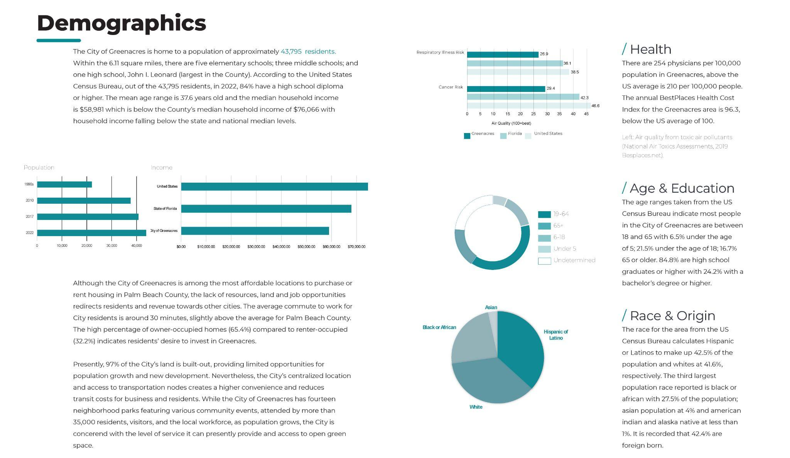
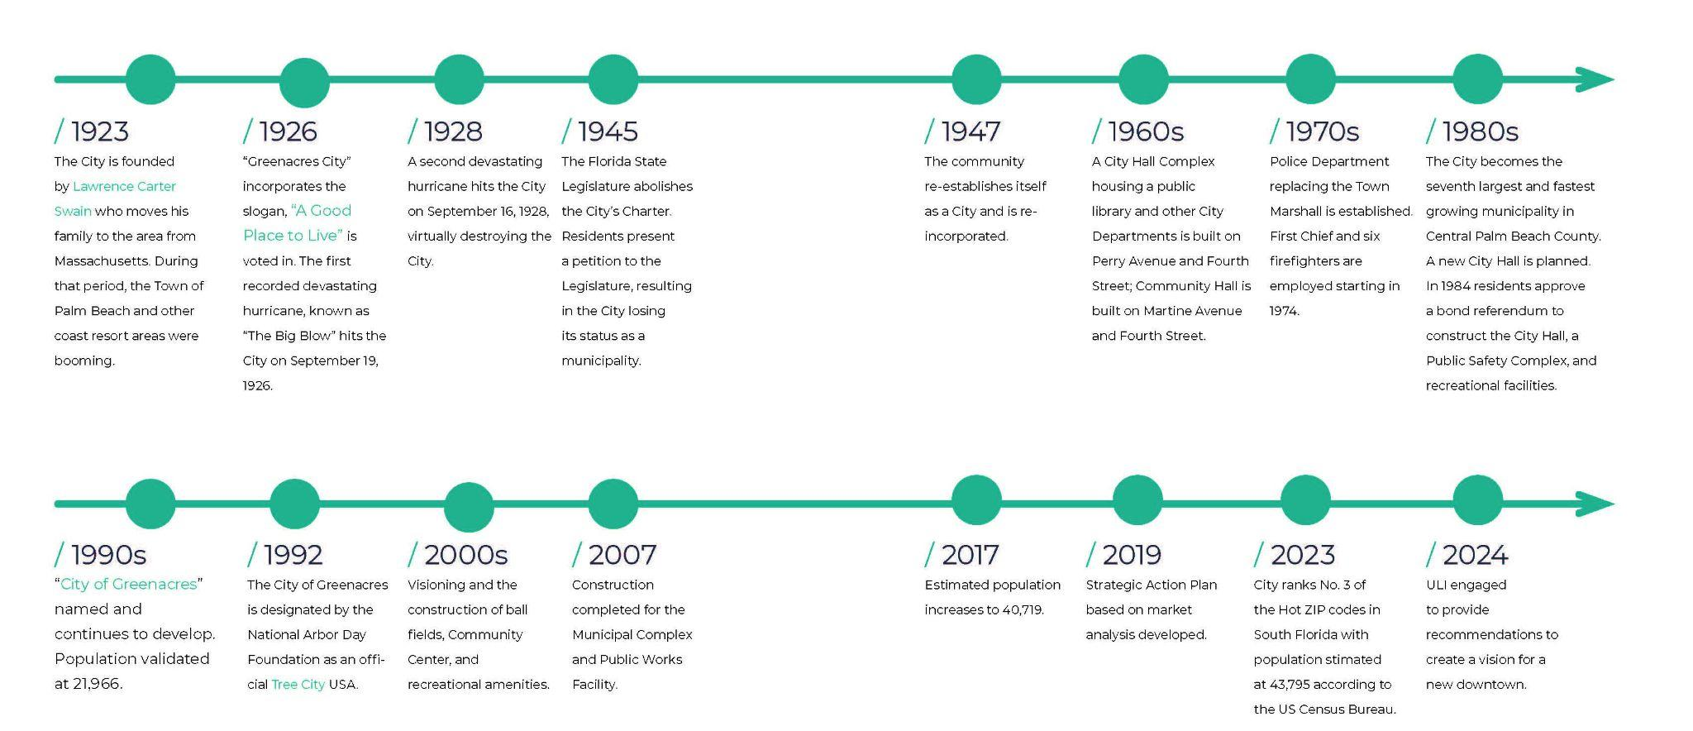
Background Research
DEMOGRAPHICS
Notes:
Typically, we would’ve conducted public outreach to better understand the community and aid in addressing these goals; however, that was a bit out of scope, so in addition to our discussions and site tour with you, we dove into City demographics, history, planning and zoning code and pulled from existing City resources like the Comprehensive Plan and 2019 Strategic Action Plan.
We felt it was important to leverage the City’s history, in particular the City’s founder, Lawrence Carter Swain who founded the City in 1923 and the City’s designation as an official “tree city” in 1992.

Slide 6
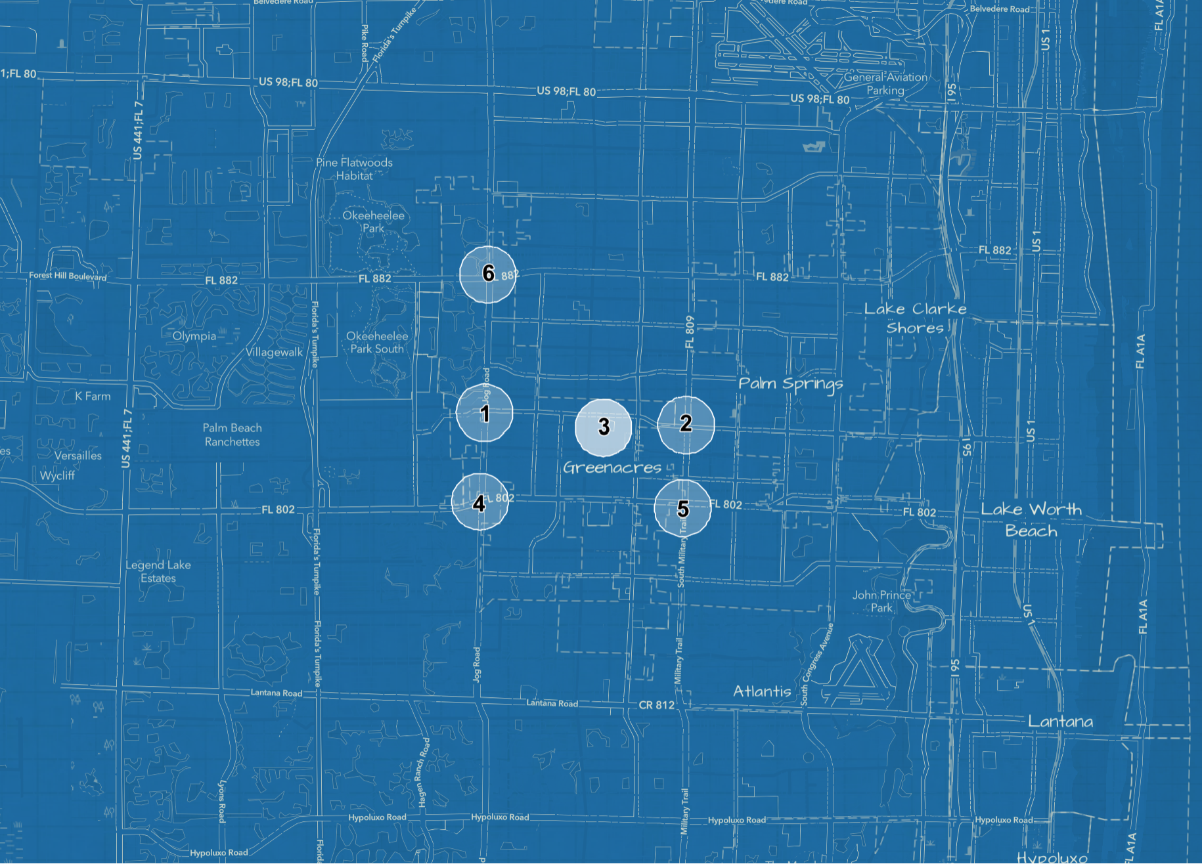
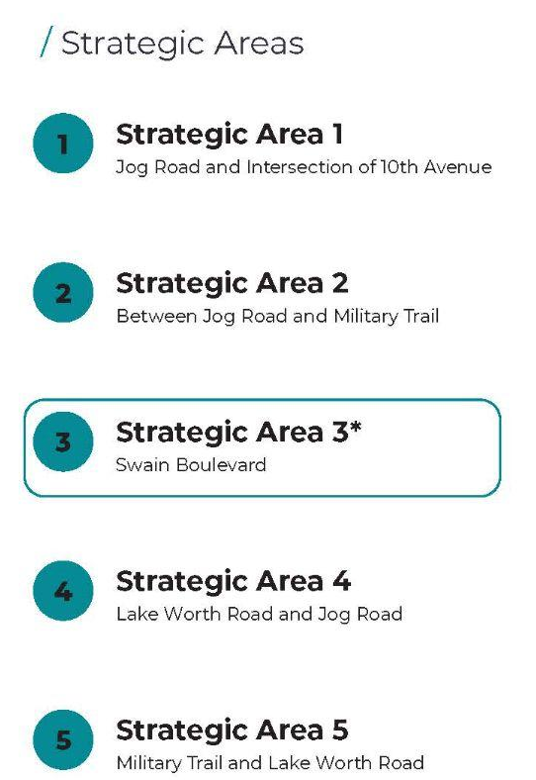
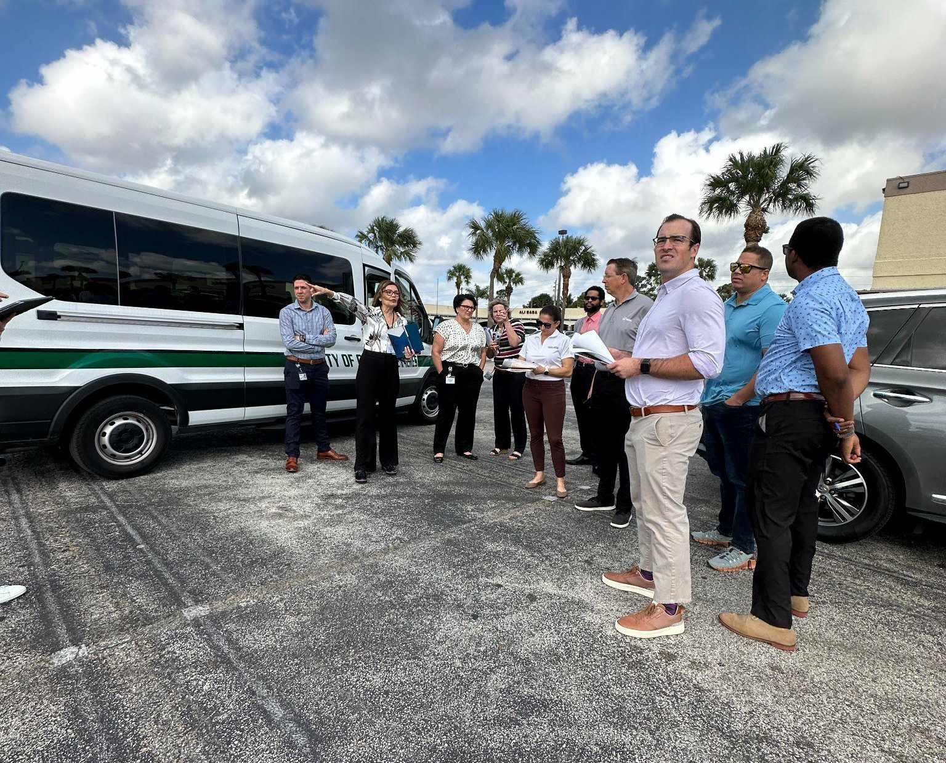
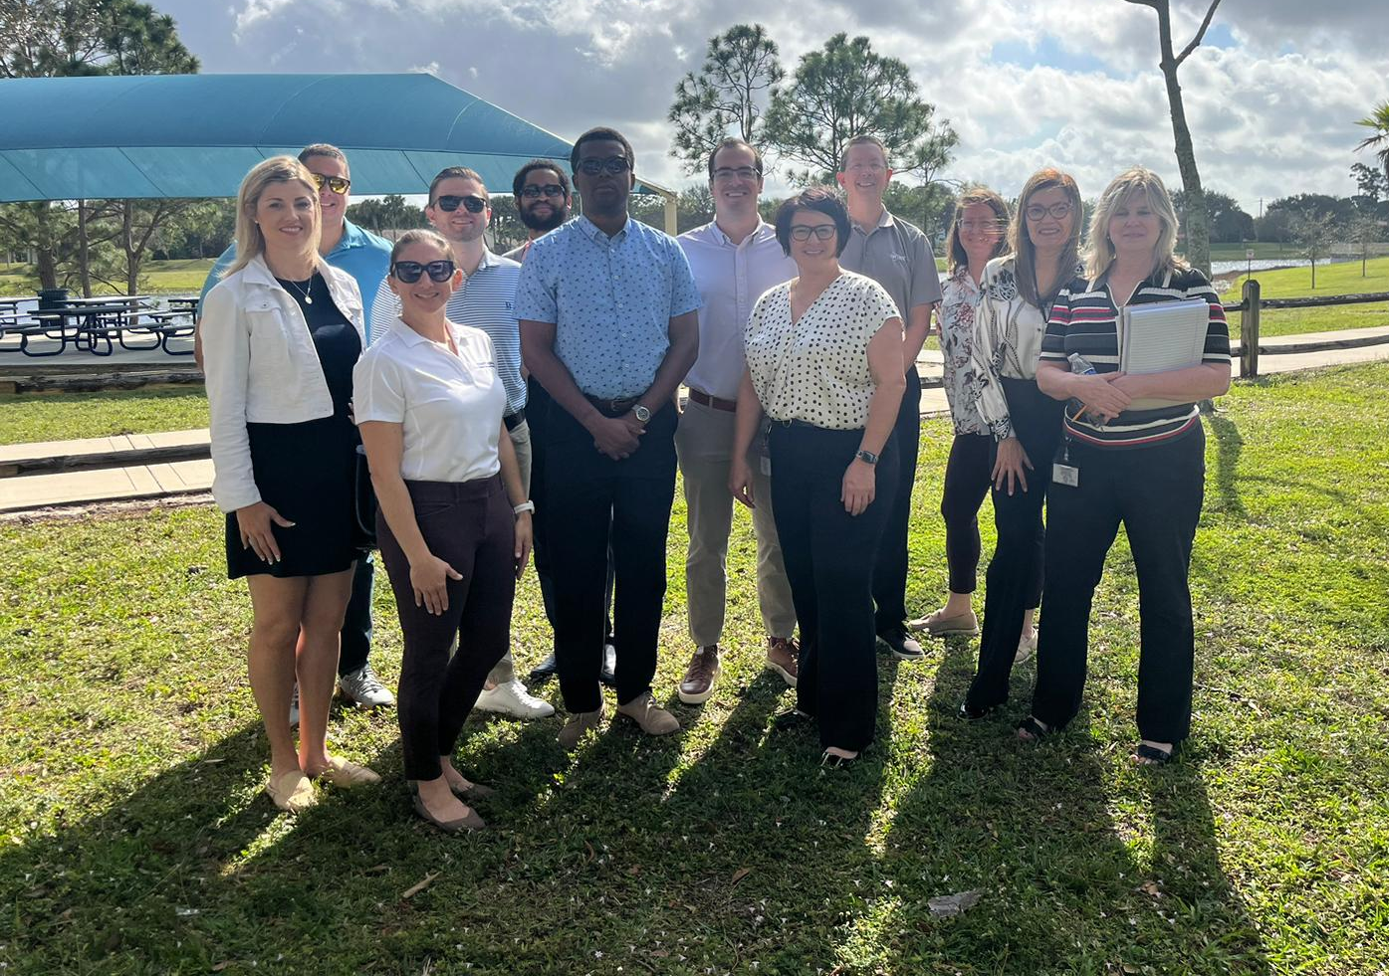
Strategic Areas
STRATEGIC AREAS
BACKGROUND
Notes:
We evaluated each site identified in the Strategic Action Plan, based on their potential to maximize development opportunities.
We also identified several relevant case studies within PBC that the City can reference as successful examples

Slide 7
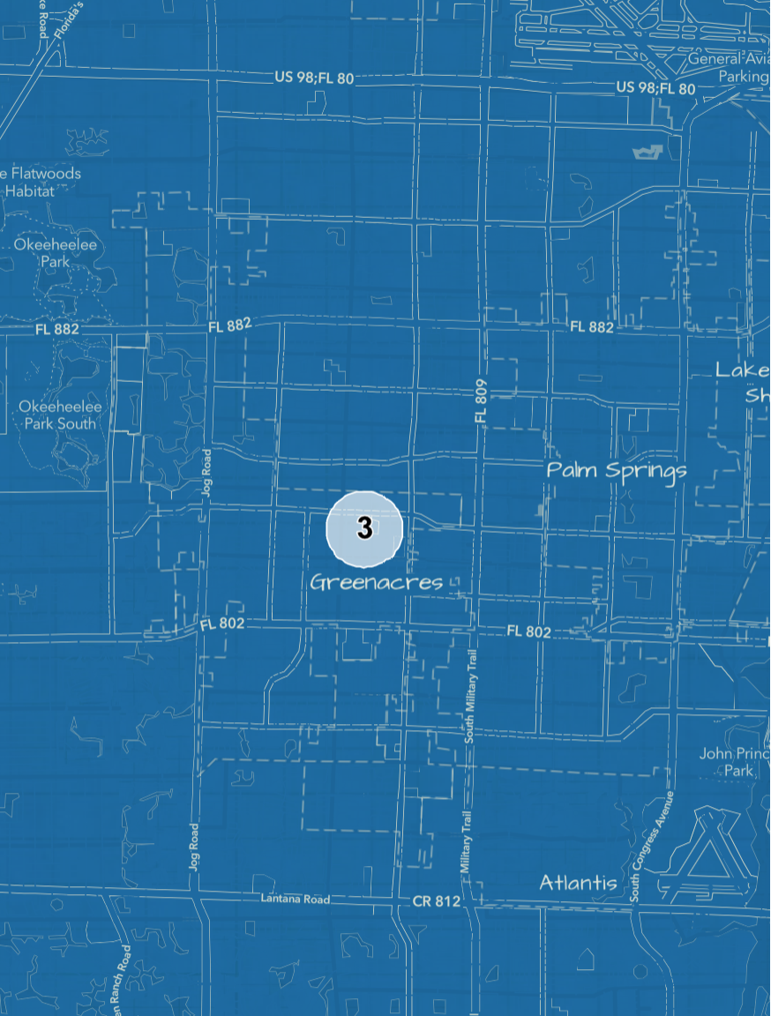
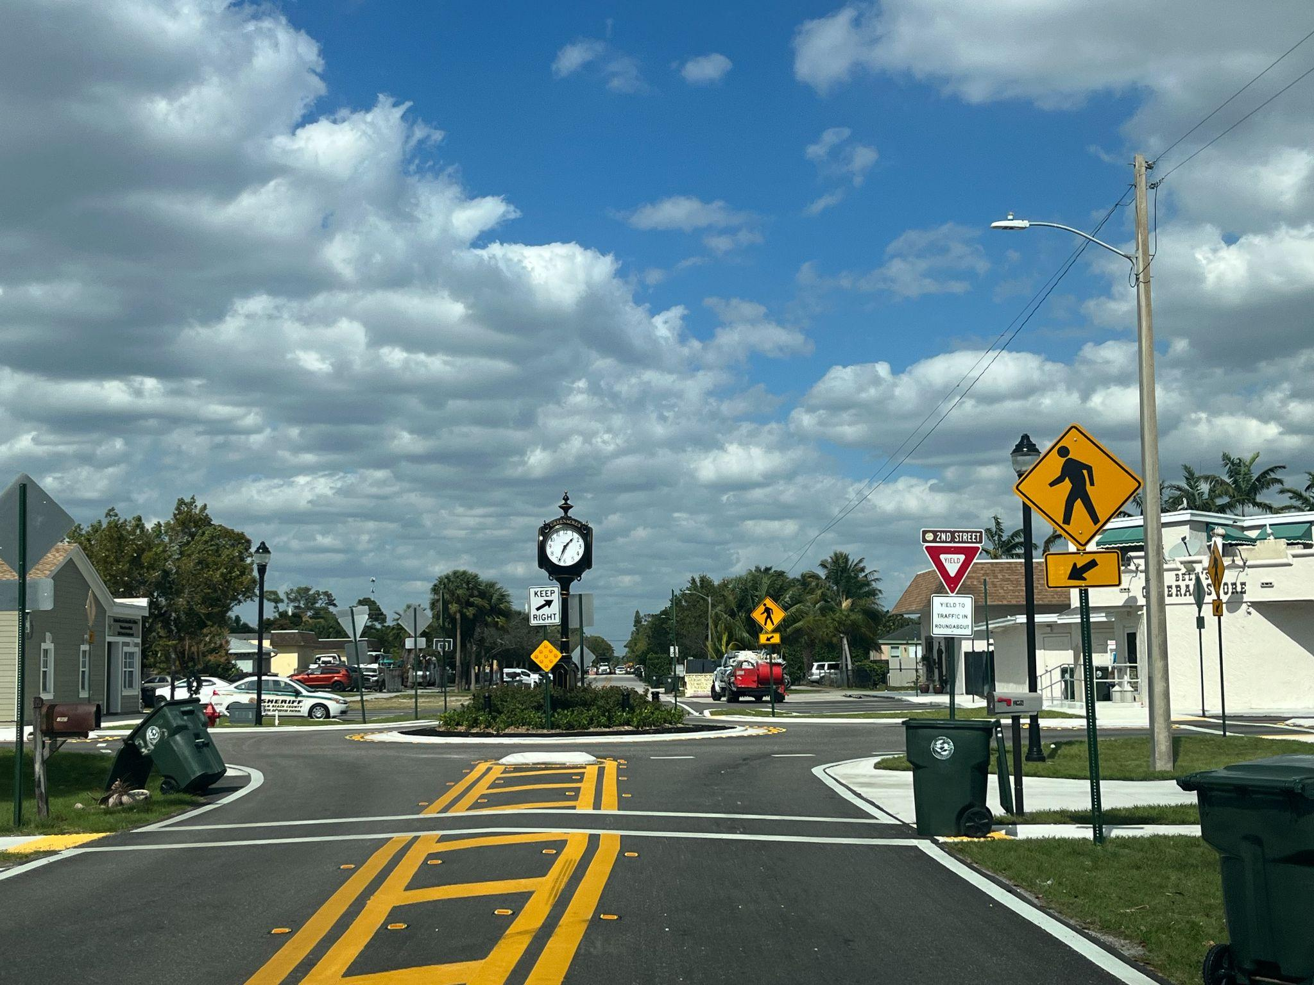
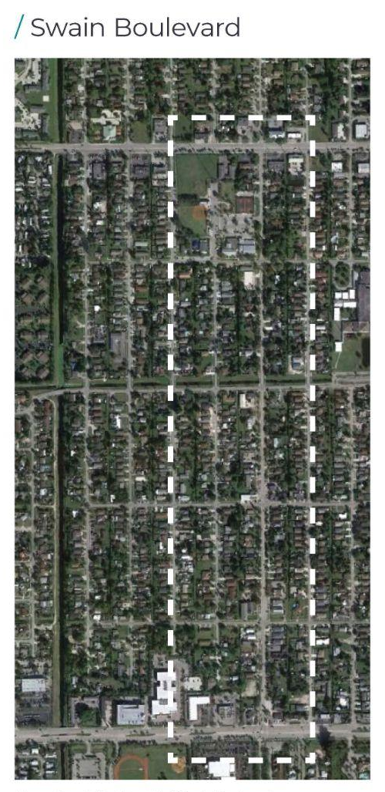
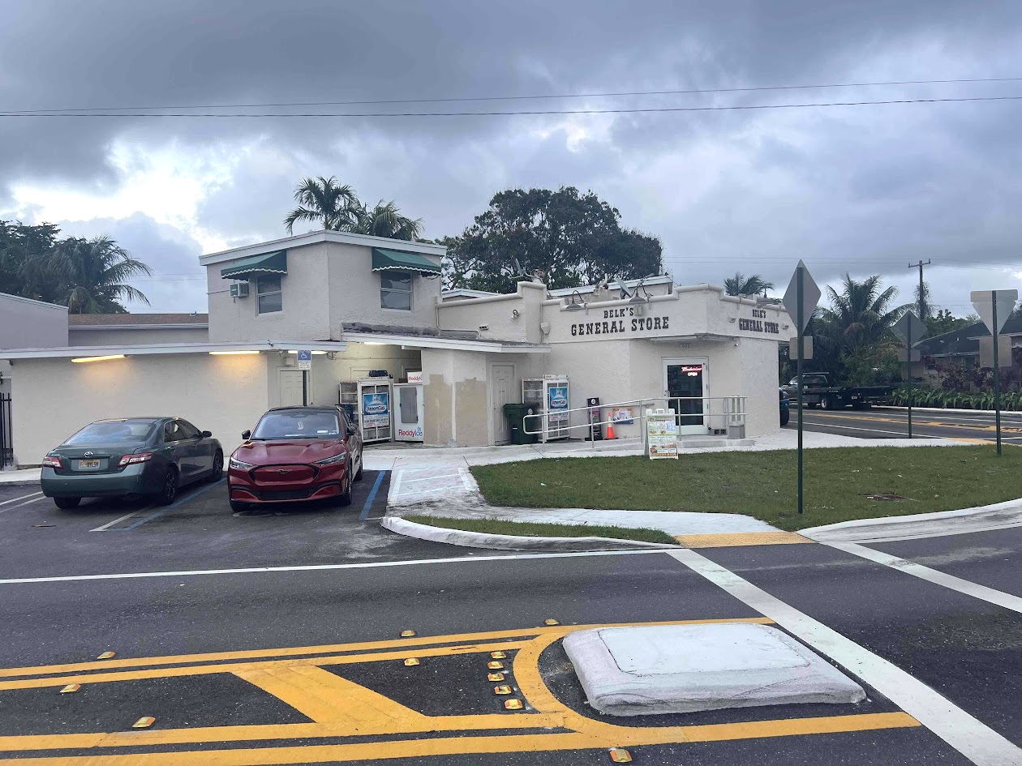
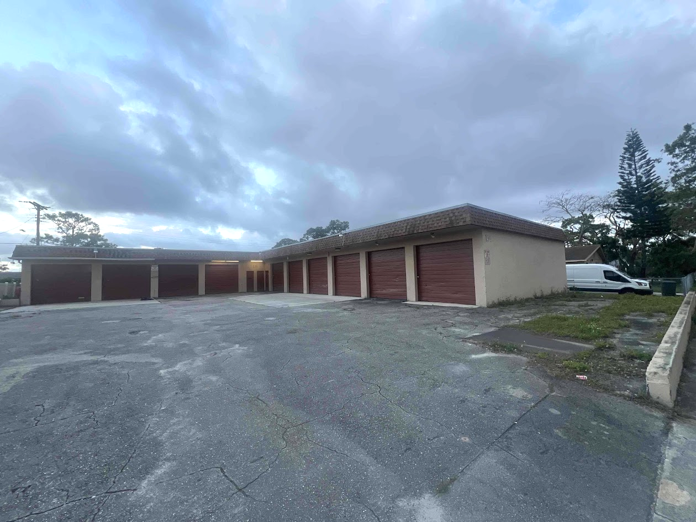
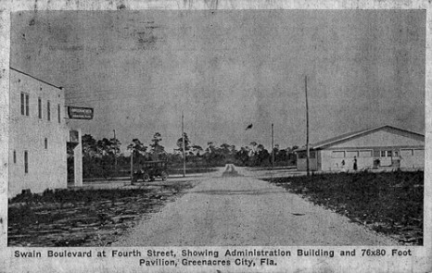
Site Selection
SWAIN
BOULEVARD
Why did we choose Swain Boulevard?
The City controls a key asset anchoring one end of the corridor.
The City has plans to improve the streetscape, which could kick-start the creation of a downtown.
There are many smaller properties, each of which could contribute to a downtown, rather than be dependant on one single landowner.
Swain is the City’s historic and original section.
PROJECT SITE
Notes:
Based on our research and analysis, we selected Swain Blvd, between 10th Avenue to the north and Lake Worth Road to the south for the future downtown location of Greenacres.
We believe this site has the potential to provide an appropriately scaled, pedestrian-oriented downtown.
And benefit from major investments towards building a centralized downtown and planning for future growth
The existing Community Center is at the northwest section
There are Current infrastructure improvements underway, including plans for enhanced streetscape
The area is named after the City’s founder, Lawrence Carter Swain and is located within the historic section giving us that opportunity to build on its historical significance, creating a centralized, identifiable area
As well as foster new amenities, community initiatives, and business ventures

Slide 8
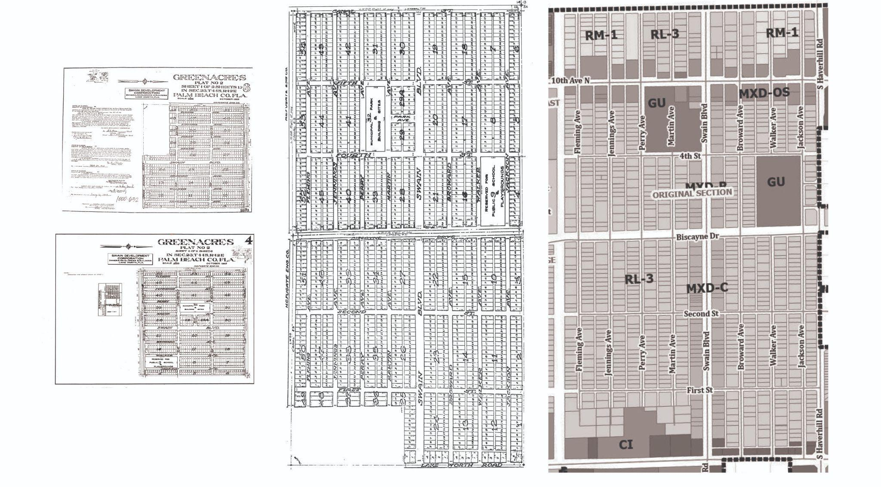
The Original Section Platting
Original Platting
Original Swain Section
Current Section
Notes:
Furthermore, Trisha found the original plat for the original section from 1925 which still exists today.
The main N/S corridor, “Swain Blvd”, is still preserved in the current section
And although some of the lots have shifted in ownership and changed over time, we were really excited to find this history component to support zoning and land use changes for this area to address not only the street but an entire section of downtown

Slide 9
Key Actions by Focus Area Overview
Mixed-Use & Commercial Property Opportunities
Transportation & Infrastructure Improvements
Green Improvements & Access to Open Spaces
Placemaking &
Art in Public Places
Acquisition of additional properties along Swain and rehabilitation of existing buildings for growth opportunities
Increase urban density/raising heights along swain and diversity housing mix
Integration of live-work within the new housing mix
Create a mixed-use special zoning district along Swain Boulevard
Encourage P3 developments
Continue to improve infrastructure along Swain Boulevard to include on-street parking and bicycle transportation
Leverage existing City-owned transit and infrastructure
Expand programmatic uses for public outdoor recreation and recreational amenities at Community Center Irva Van Bullock Park
Enhanced tree canopy (tree city) and native plantings
Integrate native planting and sustainability learning programs through street markets in new plaza
Develop community center as a cohesive master planned area to serve as a new hub connected to Swain with community benefit opportunities such as educational programming
Create a sense of place to be in, not drive through where people want to invest and be
Flexible community gathering spaces to include a centralized pedestrian plaza and and outdoor amphitheatre for large events and programming opportunities such as markets, local vendor days, and job and job training fairs
Art in public places for installations and cultural expression
Programming to allow for local business participation
Notes:
To execute our four core goals, we’ve structured our recommendations into four key areas of focus, which will be discussed in detail next. These areas are…
Mixed-Use & Commercial Property Opportunities
Transportation & Infrastructure Improvements
Green Improvements & Access to Open Spaces
Placemaking & Art in Public Places

Slide 10
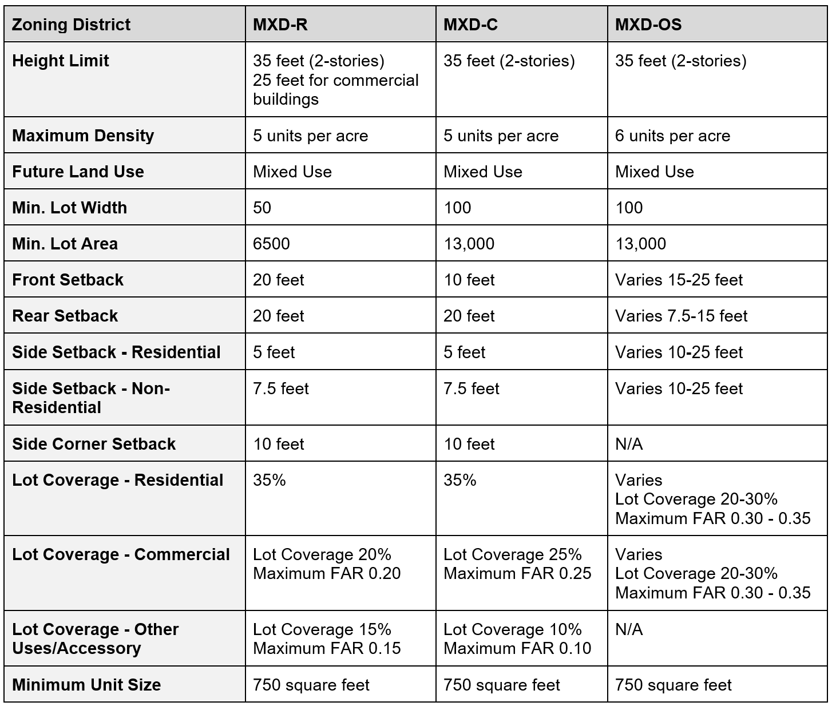
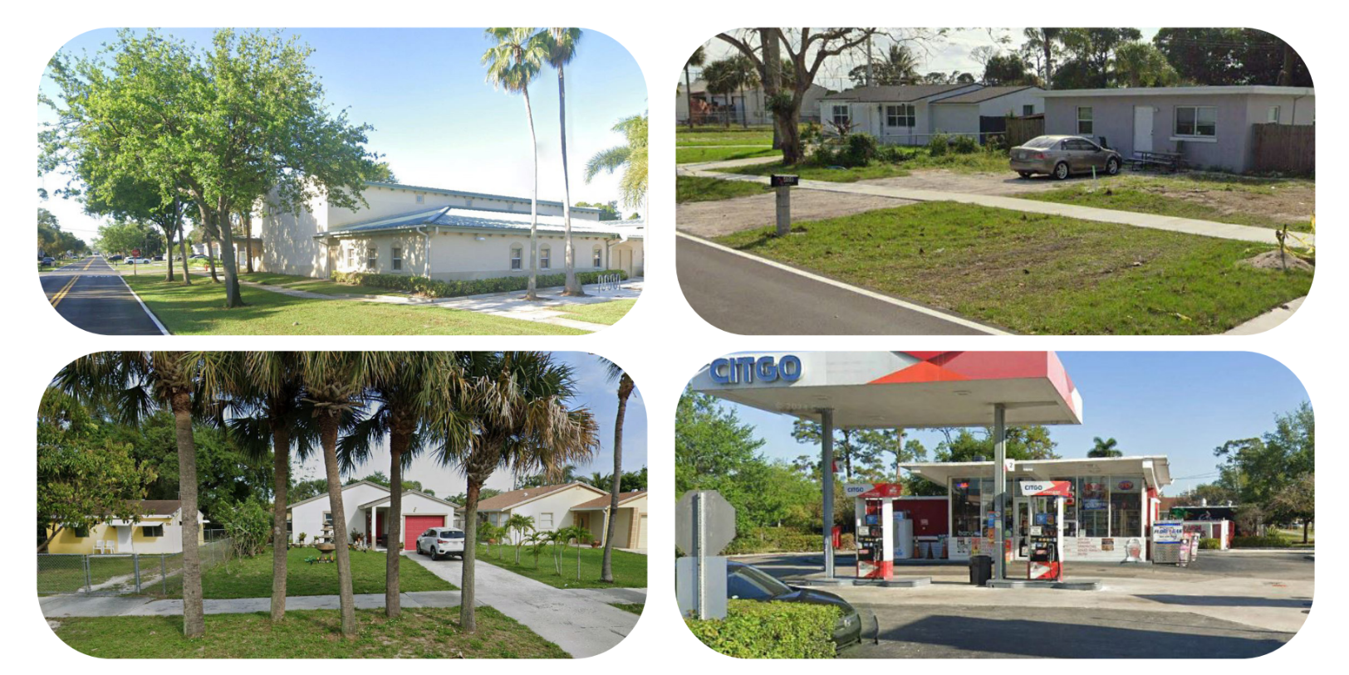
Planning & Zoning Analysis
EXISTING CONDITIONS & ZONING REGULATIONS
Notes:
Mixed Use Residential (MXD-R)
Mixed Use Commercial (MXD-C)
Mixed Use Development Original Section (MXD-OS)
Within the surrounding area is Residential Low Density (RL-3).
The predominant existing use on Swain Boulevard and in the Original Section are single-family homes.
The MXD-R zoning district permits single-family homes, professional offices, and medical/dental offices. The MXD-C zoning district is more permissive, allowing the same single-family and office uses that are allowed in the MXD-R district but also permitting a variety of retail uses including
service establishments, restaurants, and banks. Finally, the MXD-OS district permits a wide range of retail and commercial uses. However, the MXD-OS district only permits multifamily residential units as an accessory use to a commercial use that must be physically integrated with the commercial structure.

Slide 11
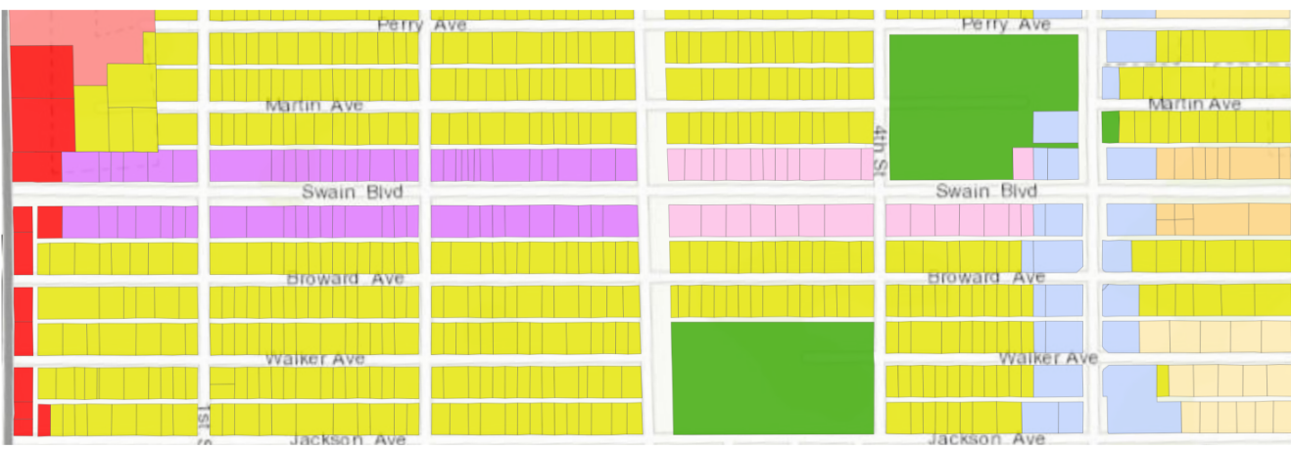
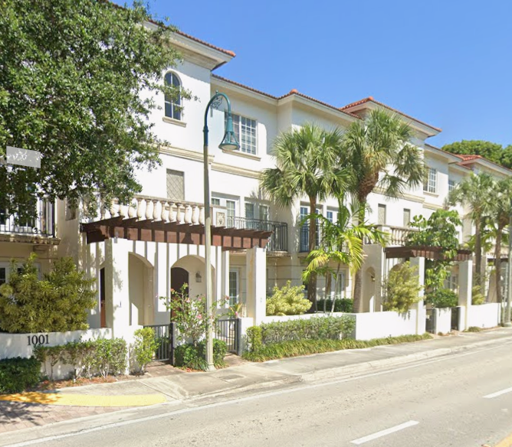
Planning & Zoning Analysis
CITY ZONING
45 feet (3-stories)
55 feet (4 or 5-stories)
15 units per acre
5 feet
0 – 5 feet
5 feet
5 feet
5 feet
Change the RL-3 zoning regulations that surround Swain Boulevard to allow townhouses as a permitted use and increase the allowable density to 15 units per acre
Lot Coverage 75%
Max. FAR 0.75

Slide 12
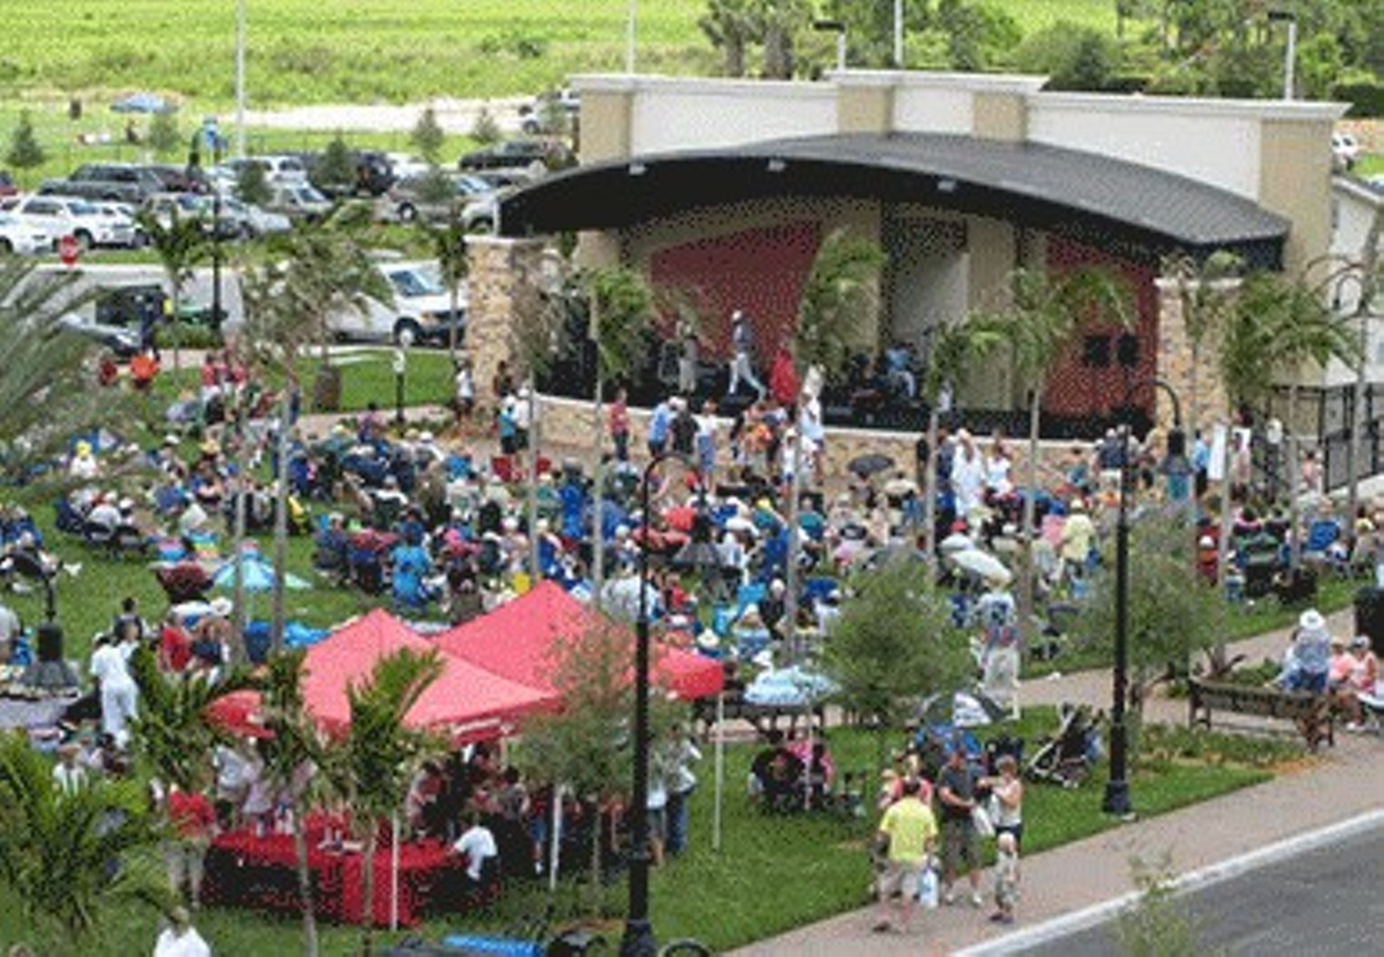
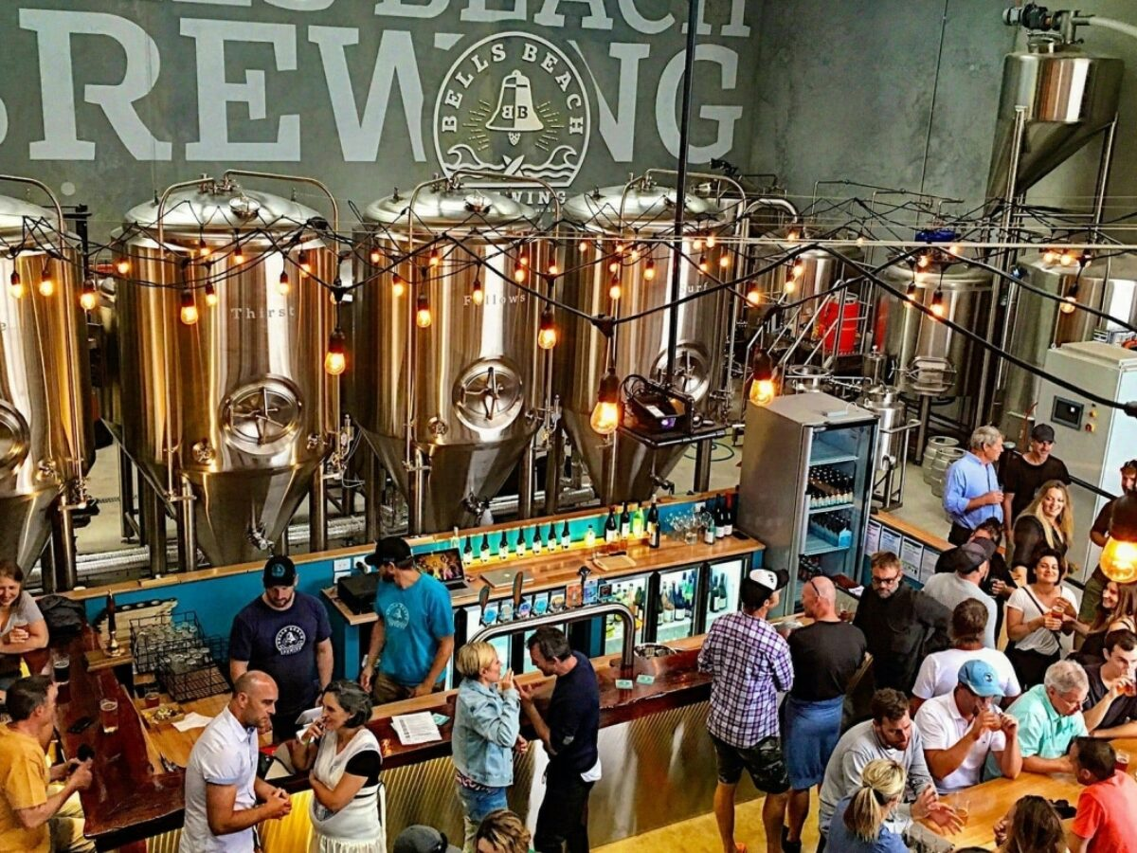
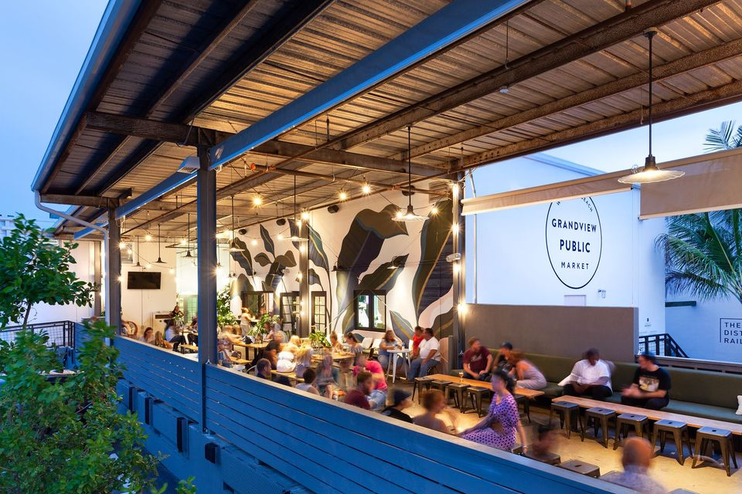
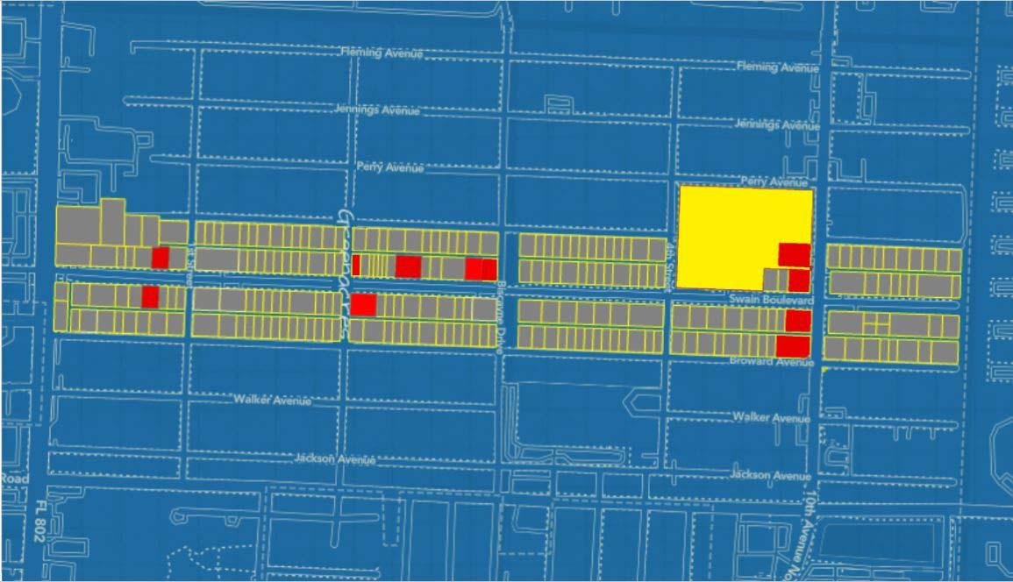
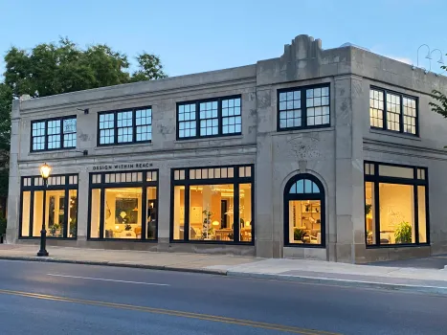
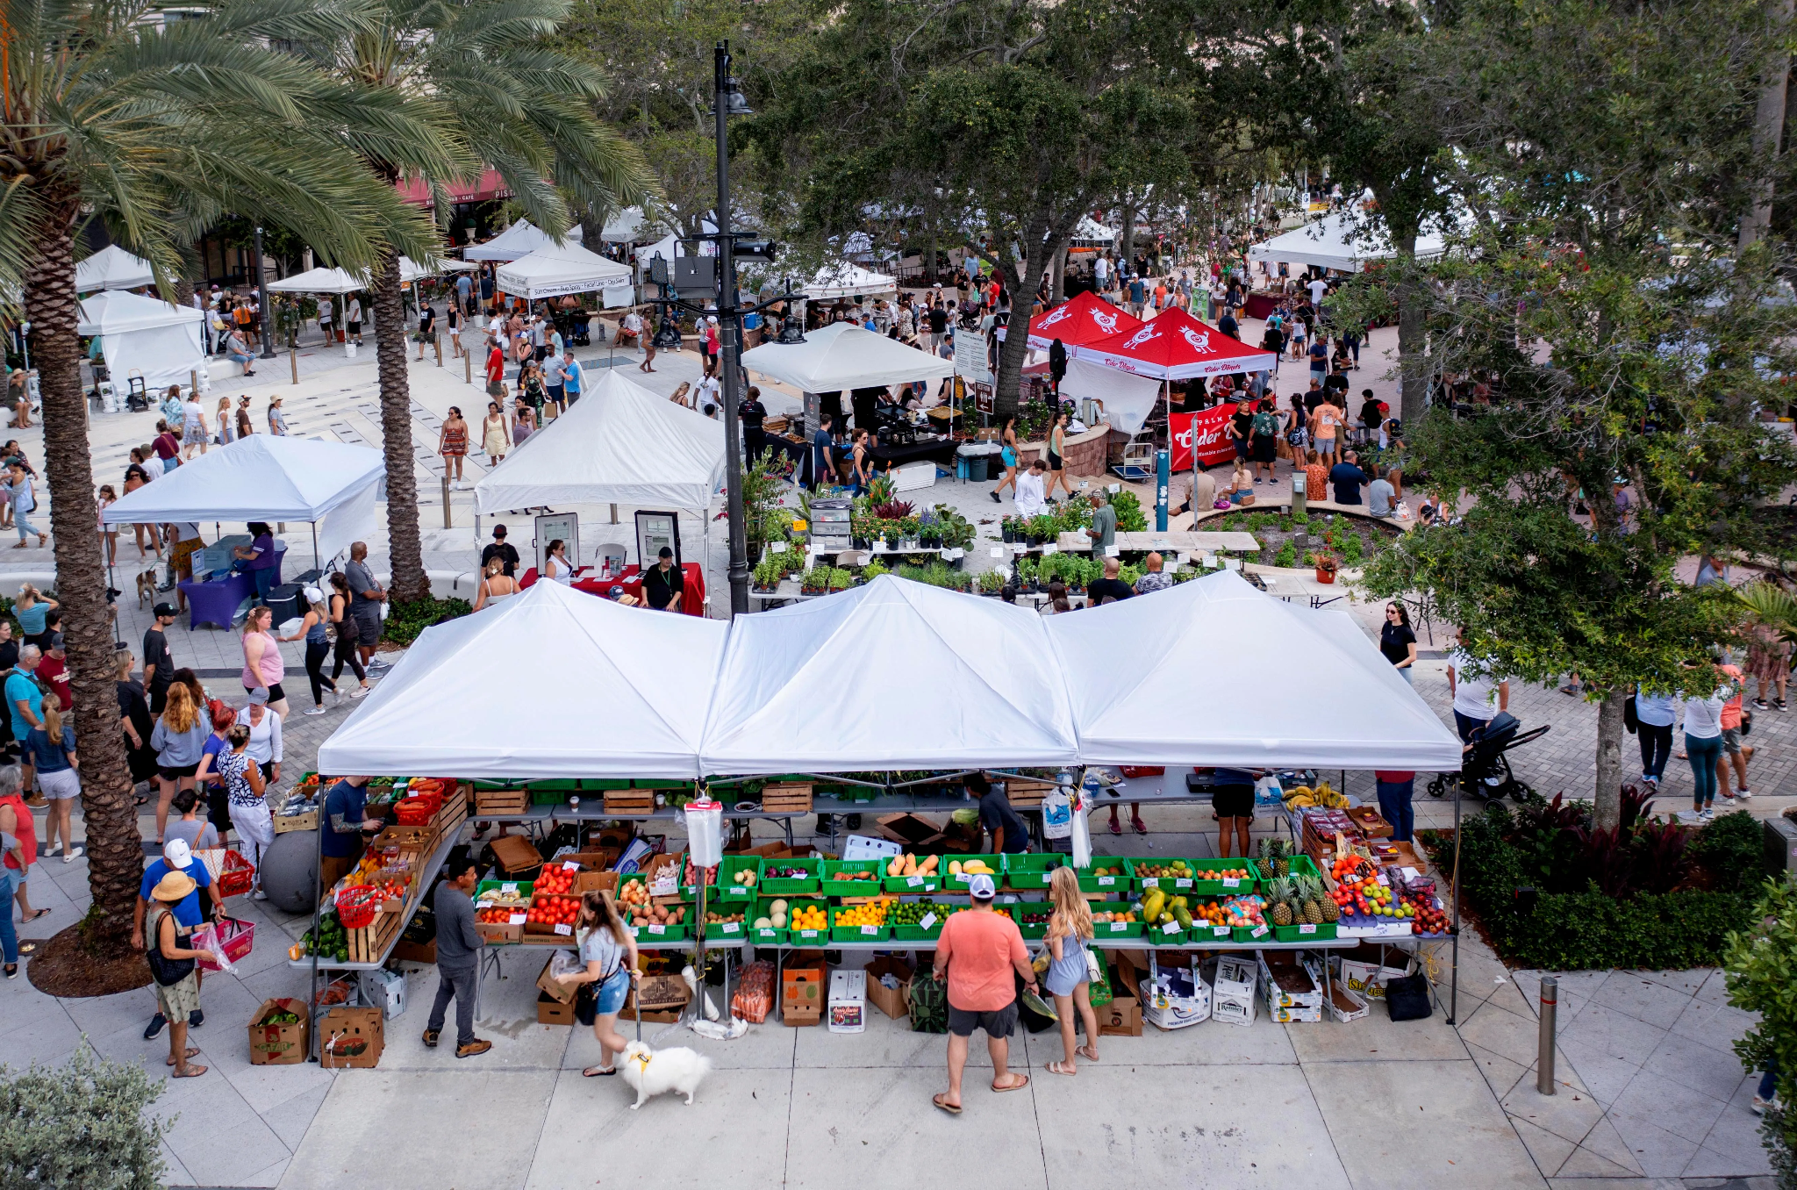
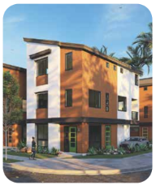
Mixed-Use & Commercial Property Opportunities
Example Brewery
Canyon Center Amphitheater
Grandview Market
Example Adaptive Reuse Retail
WPB Green Market
Example Live/Work Units

Slide 13
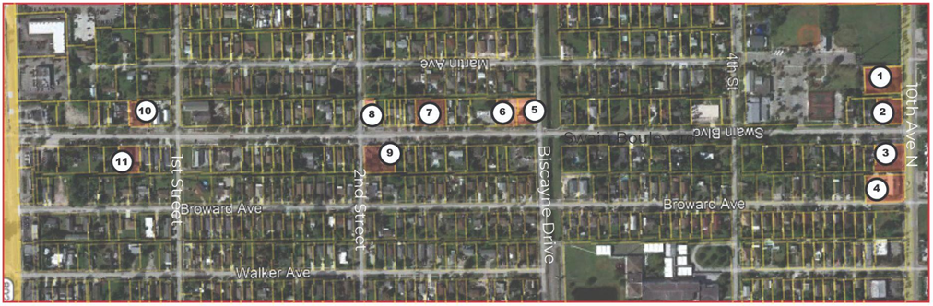
Mixed-Use & Commercial Property Opportunities

Slide 14
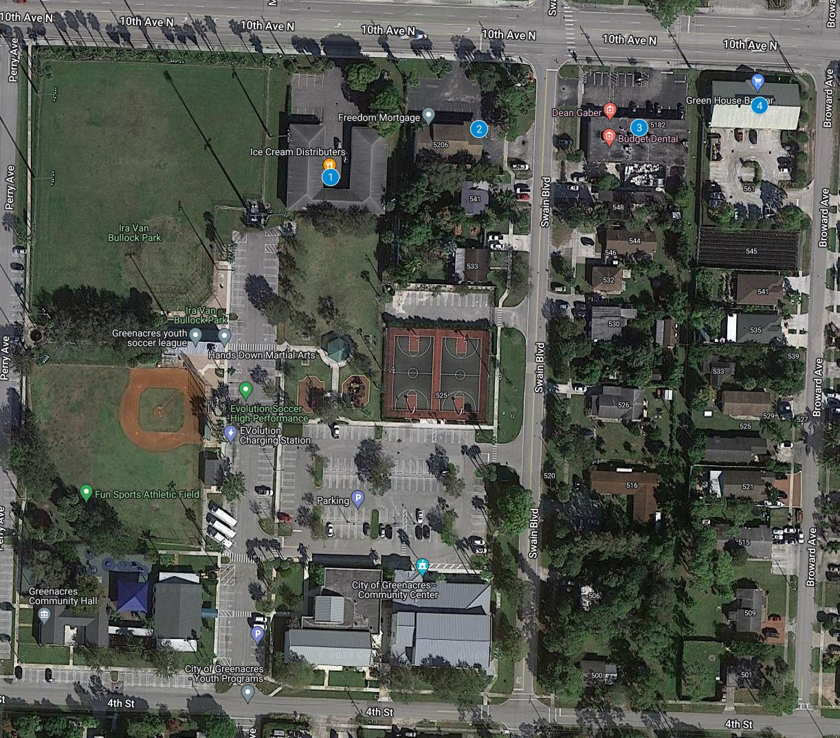
Mixed-Use & Commercial Property Opportunities
5280 10th Ave N
5202 10th Ave N
5190 10th Ave N
5100 10th Ave N - Green House Bazaar
The south side of 10th Avenue North features two key commercial properties, a 9,000 square foot warehouse at 5280 10th Avenue and a 3,400 square foot office building at 5202 10th Avenue, adjacent to the City Community Center.
Repurposing these properties for active retail or restaurant use could create a vibrant activity node at the Swain Boulevard gateway, especially if in collaboration with Green House Bazaar, enhancing community engagement and economic activity.

Slide 15
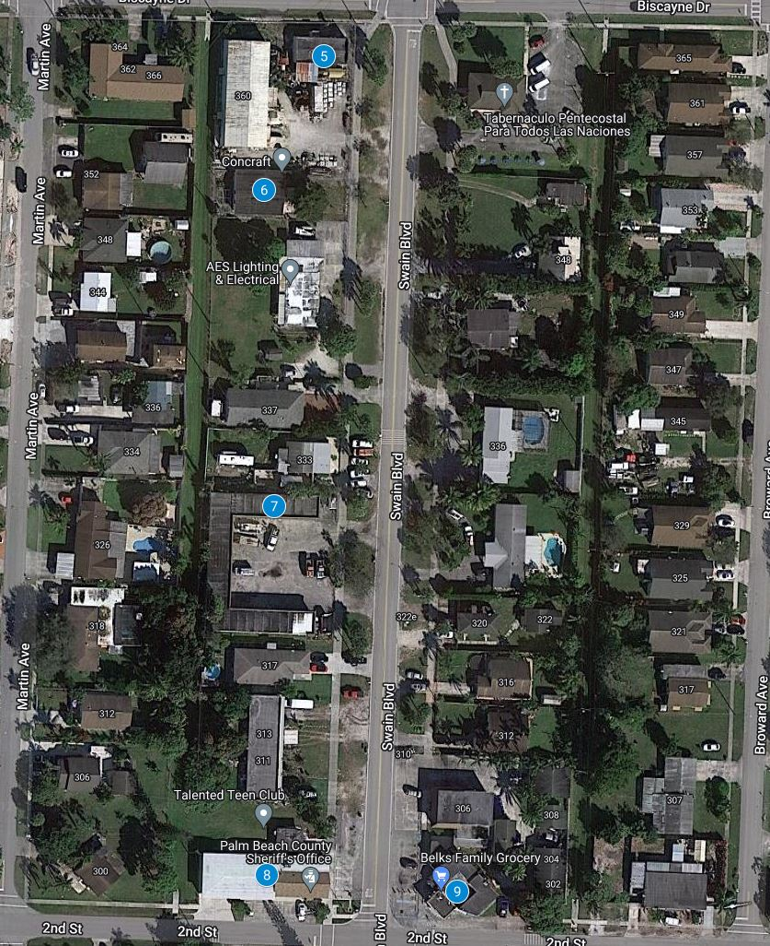
Mixed-Use & Commercial Property Opportunities
5. 355 Swain Blvd
6. 353 Swain Blvd
7. 325 Swain Blvd
8. 301 Swain Blvd - Palm Beach County Sheriff’s Office
9. 300 Swain Blvd - Belk’s Family Grocery
The Fire Rescue and Sheriff building at 301 Swain Boulevard should be more actively utilized, potentially in collaboration with the Talented Teen Club at 305 Swain Boulevard. Belk’s General Store at 300 Swain Boulevard could benefit from storefront rehabilitation to enhance its inviting street frontage. Additionally, the flex warehouse at 325 Swain Boulevard could serve as an artist or small business incubator, and the industrial building at 353-355 Swain Boulevard is ideal for a brewery, providing commercial activation and highlighting the historical significance of the original fire station.

Slide 16
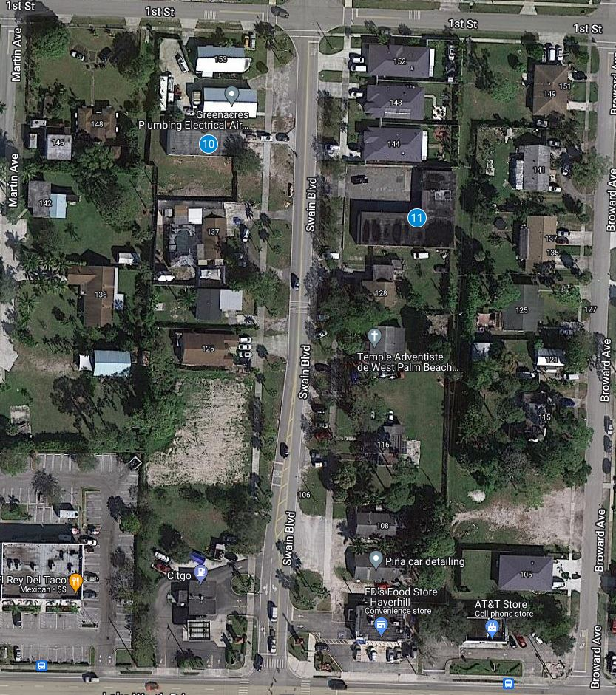
Mixed-Use & Commercial Property Opportunities
10. 145 Swain Blvd
11. 136 Swain Blvd
Similar to 325 Swain Boulevard, the flex warehouse at 136 Swain Boulevard could serve as an artist or small business incubator, hosting contests and competitions to display artwork and community projects, thereby attracting regular visitors and activating Swain Boulevard.
At 145 Swain Boulevard, home to a local contractor, collaboration with the business owner could provide training, education, and job opportunities for Greenacres citizens while enhancing the property's aesthetics and promoting the local business.

Slide 17
Mixed-Use & Commercial Property Opportunities
FUNDING OPTIONS
To fund initiatives aimed at attracting more businesses, the City of Greenacres could consider the following mix of funding sources:
State and federal grants
Public-private partnerships
Tax increment financing
Municipal bonds
Creating special assessment districts
Corporate sponsorships
Dedicated taxes or levies specifically for economic development
User fees for city services
Promoting external investment to enhance financial resources
These diverse funding strategies could support substantial economic development projects, enhancing Greenacres’ attractiveness to new businesses.

Slide 18
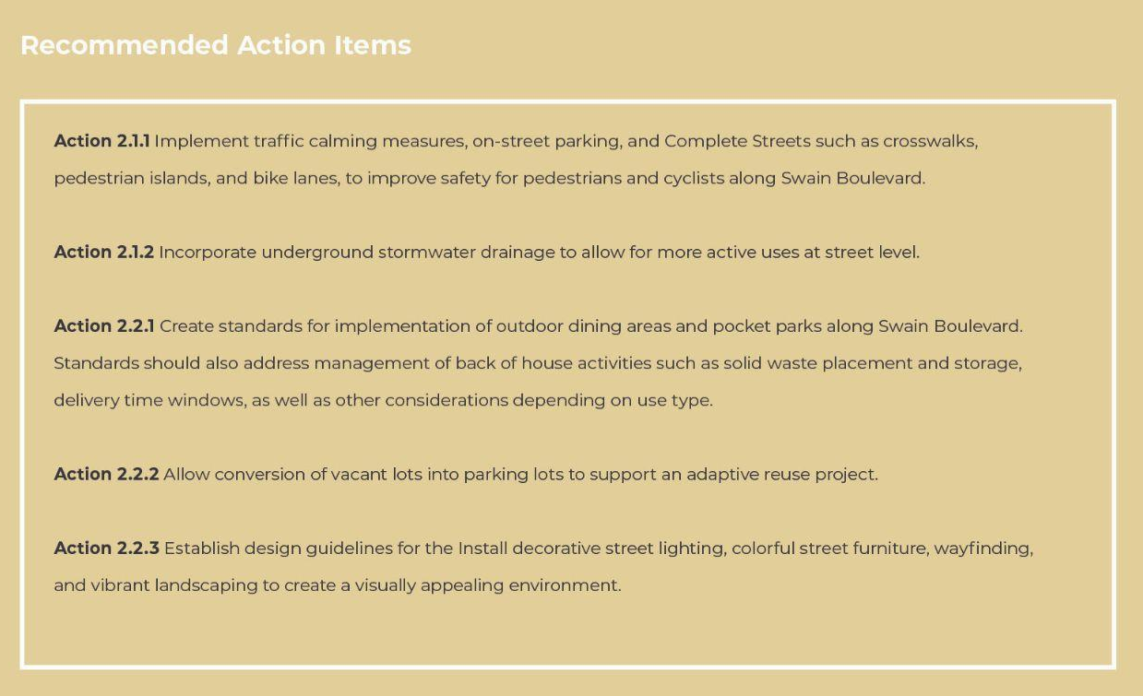
Transportation & Infrastructure Improvements
2

Slide 19
Transportation & Infrastructure Improvements
CITY OF GREENACRES COMPREHENSIVE PLAN
Transportation Element Alignment
Transportation Element Goal 1: It shall be the goal of the City of Greenacres to develop a multimodal transportation system to provide a safe, efficient movement of people, goods, and services within and through the community at a reasonable cost with a minimum detriment to the environment.
Redesigning Swain Boulevard to provide organized on-street parking and comfortable pedestrian pathways will provide a safer environment and a framework that will foster the kind of mixed use development that the City seeks to create a downtown sense of place.
Transportation Element Objective 1, Policy e) The City shall continue to promote developments that provide a mix of uses at appropriate densities and intensities, redevelopment projects, commercial revitalization projects and projects supportive of an efficient transportation system.
Currently the City’s zoning regulatory environment does not effectively promote mixed use development or a mix of uses because residential densities and commercial intensities are suppressed and multifamily residential uses are not widely permitted. The Swain Boulevard right-of-way as it currently exists also does not promote retail and restaurant users to compete for the few existing commercial properties because the public right-of-way is not an inviting “front door”.
Transportation Element Objective 2, Policy d) Improve the safety and operation of City streets, through site-access control, and other traffic operation improvements.
The improvement of Swain Boulevard Boulevard as proposed by the City with suggested modifications in this report will greatly improve the safety and operation of Swain Boulevard by removing haphazard on-street parking occurring in swales and providing organized on-street parking. Traffic roundabouts will also improve traffic flow and slow down traffic speeds while providing visual interest.

Slide 20
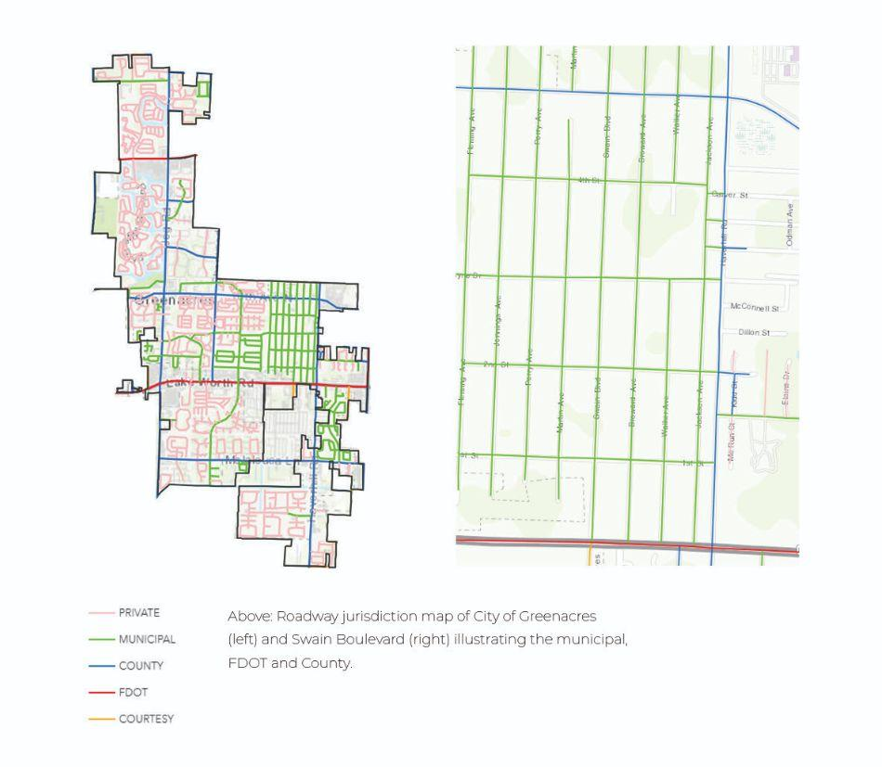
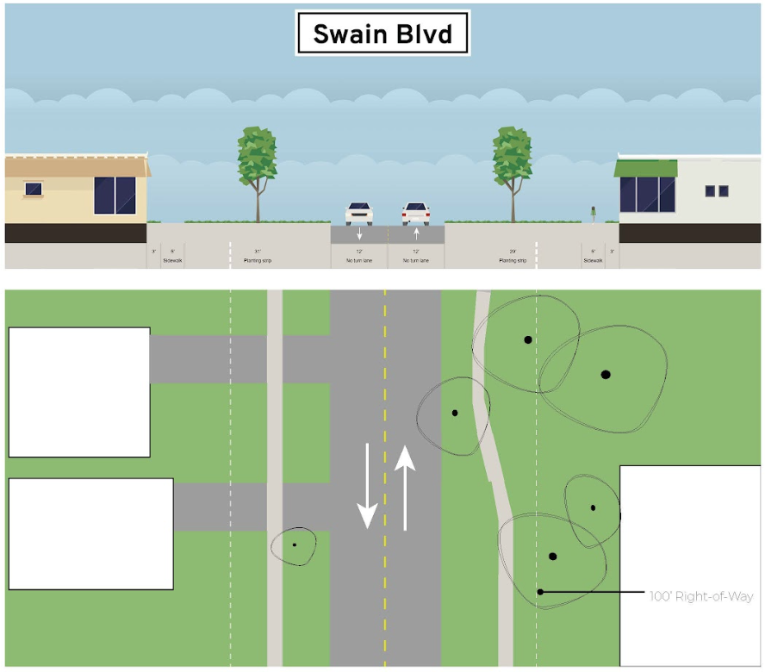
Transportation & Infrastructure Improvements
Existing Condition

Slide 21
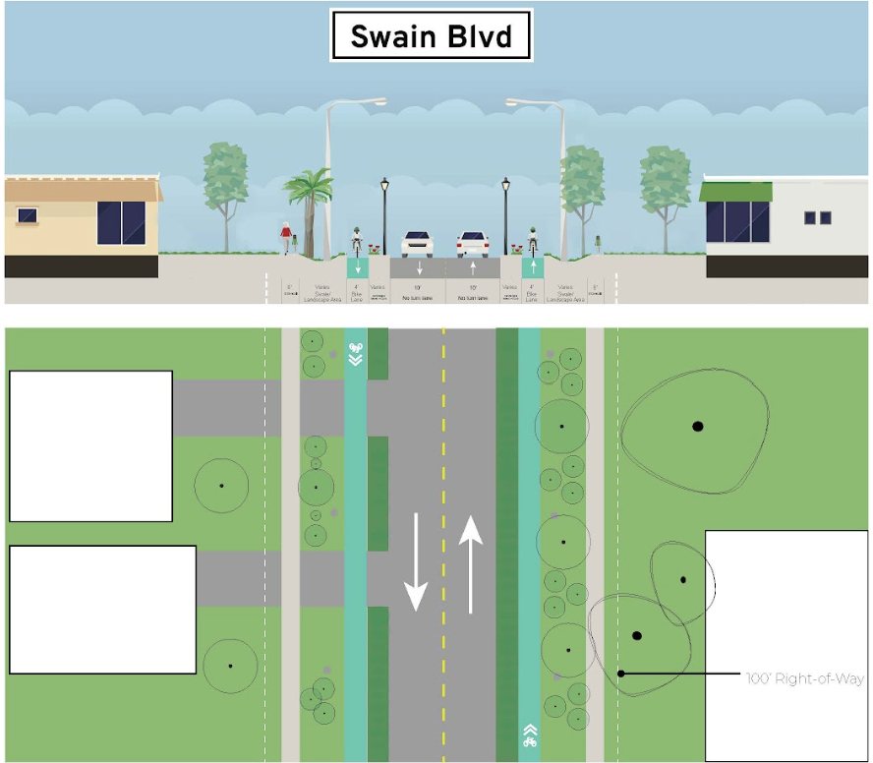
Transportation & Infrastructure Improvements
CURRENT PLANNED FUTURE PROPOSED IMPROVEMENTS
Increase sidewalk from 5ft to 6ft
Reduce roadway from 12ft to 10ft
Bike lanes on both side of the roadway
Street lights, swale
Current Planned, Future Proposed

Slide 22
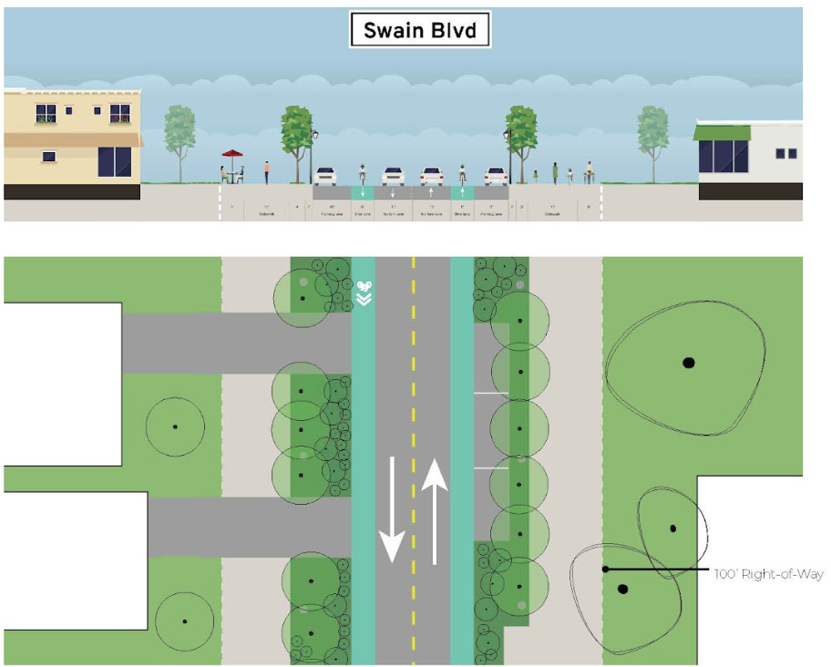
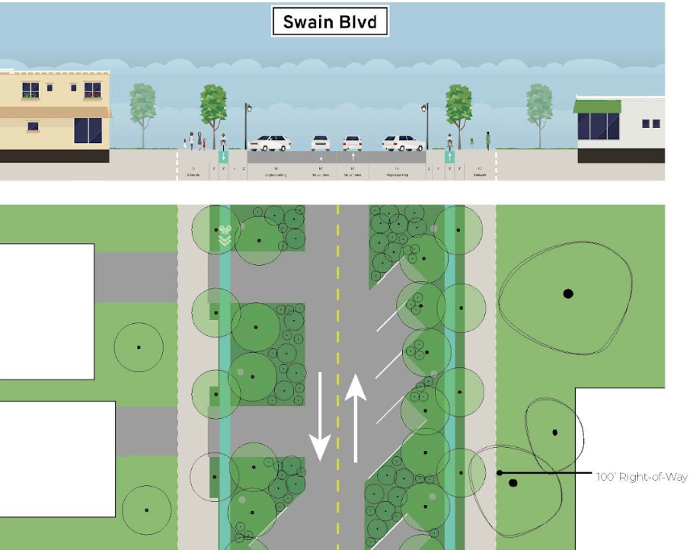
Transportation & Infrastructure Improvements
Broward Ave
Proposed Option A (Parallel Parking)
Proposed Option B (Angled Parking)
Biscayne Dr.
Notes:
Improve the Swain Blvd ROW to include more complete Street features and amenities such as on-street parking, public art, and green infrastructure.

Slide 23
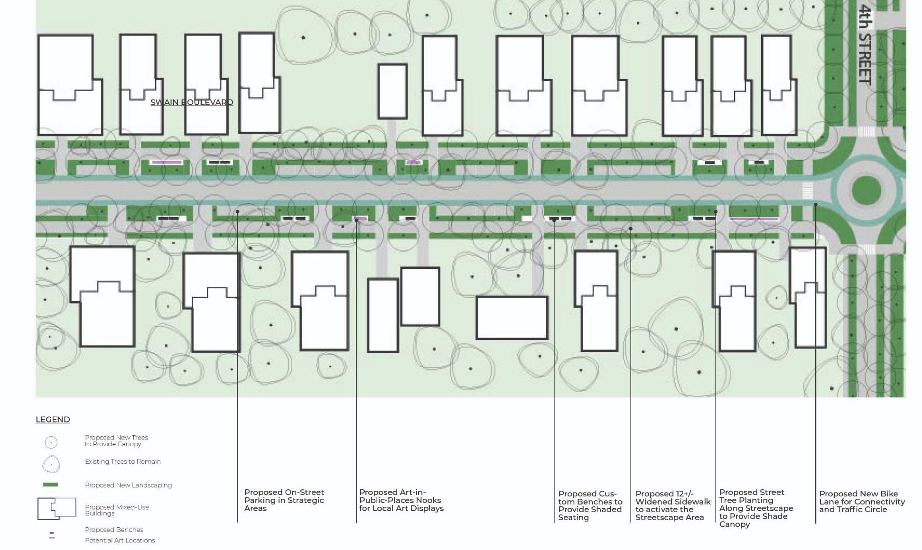
Transportation & Infrastructure Improvements
Proposed Streetscape Improvements
Notes:
Improve the Swain Blvd ROW to include more complete Street features and amenities such as on-street parking, public art, and green infrastructure.

Slide 24
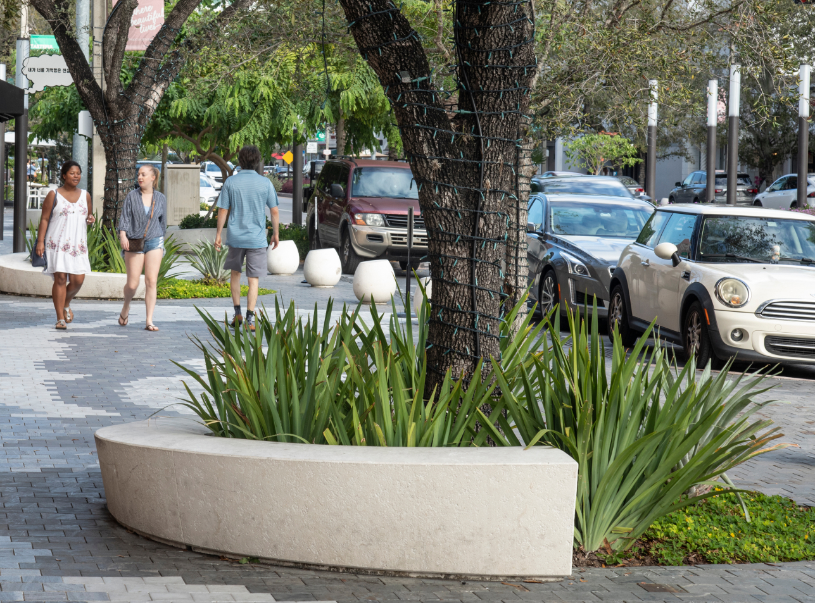
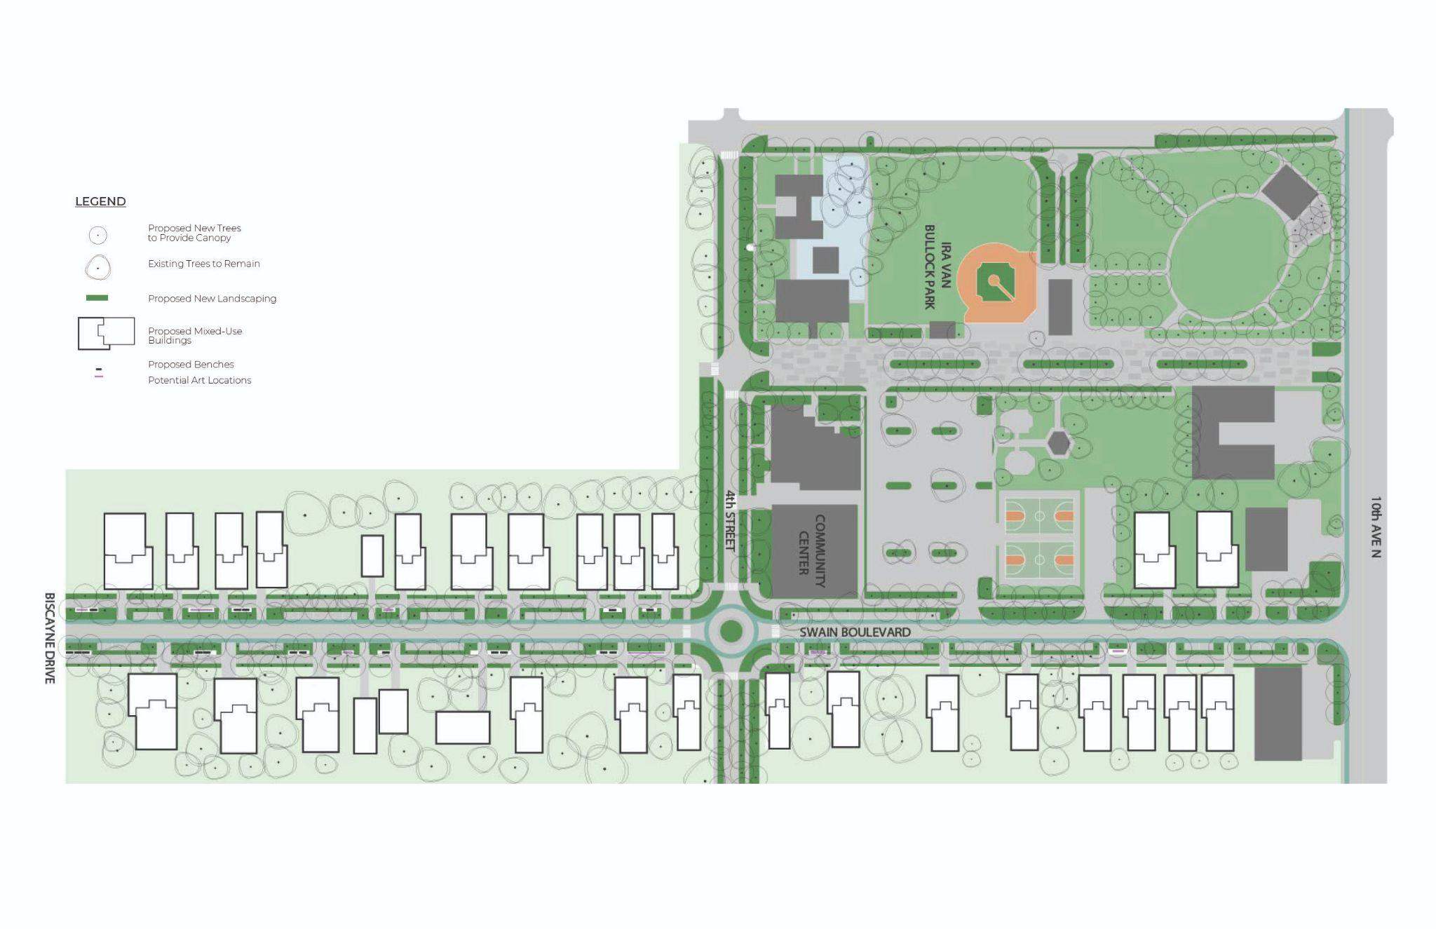
Transportation & Infrastructure Improvements
Streetscape with Vibrant Identity, Planting and On-Street Parking
Streetscape: Miracle Mile, Coral Gables, Florida

Slide 25
Transportation & Infrastructure Improvements
FUNDING
Within the Swain Boulevard area, the City is completing Capital Projects to convert the septic system to sewer. Funding provided through the Safe Streets and Roads for All (SS4A) Grant Program, U.S. Department of Transportation, was awarded for Planning and Demonstration that was used to develop a Complete Streets plan. Additional funding was provided through the same grant program for implementation of this plan.
The National Association of City Transportation Officials, the Florida Department of Transportation, Palm Beach County, and the Palm Beach Transportation Planning Agency have ample resources to educate and provide technical support to industry professionals and elected officials. The TPA and FDOT, through the Transportation Alternative Program, allocate an estimated $5.1 million, with up to $1.5 million available per project to fund sidewalks, bicycle facilities, and roadway safety projects.
Additionally, temporary installations may be implemented along Swain Boulevard through the use of tactical urbanism to test potential solutions and further understand positive impacts that the community could benefit from if permanently installed.

Slide 26
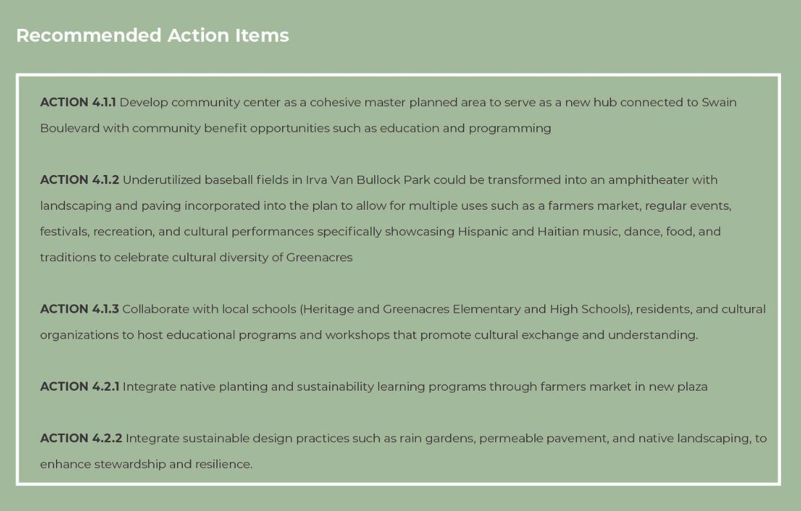
Green Improvements & Access to Open Spaces
3
Recommendations
Transform Swain Boulevard into a vibrant, walkable, downtown, with sense of identity unique to Greenacres
Initial investments by the City of Greenacres
  Redevelop community center
  Streetscape improvements
  Redevelop commercial buildings
  Provide placemaking
Private sector investment to follow
  Unify and simplify zoning districts around Swain
  Update zoning language to allow low-density walkable developments (townhomes, retail, live/work mixed-use)

Slide 27
Green Improvements & Access to Open Spaces
CITY OF GREENACRES COMPREHENSIVE PLAN
Recreation & Open Space Element
ROSE Objective 1, Provision of Parks and Facilities: The City shall adopt a comprehensive program program to ensure that, at a minimum, the level of of service for parks and recreation facilities is maintained at 3.0 acres per thousand population, with an even distribution and supply of parks and recreation facilities throughout the City that meets the needs of all citizens and visitors.
Redesigning Swain Boulevard and developing the community center and park at Ira Van Bullock Park will provide an expanded programmatic diversity of passive and active recreational opportunities to meet the evolving needs of the citizens and visitors. By incorporating tree planting enhancements and native planting areas, the City is not only beautified, but able to perform at mitigating stormwater events, excessive heat, as well as noise and air pollution.
ROSE Objective 3, Public Access) Continue to provide automobile, bicycle and pedestrian access to all public recreation facilities.
Improving the streetscape along Swain Boulevard to include a “Complete Streets approach” with a bike lane will help to enhance connectivity and overall access to the community park, open spaces and public amenities at the core of the new downtown area consistent with the objective above.
ROSE Objective 6) The City shall continue to exercise its authority to designate land for open space. Policy b) The City shall continue to convert publicly-owned vacant land to passive and active recreational areas.
The improvement of Swain Boulevard as an interconnected Master Planned streetscape would expand the Comprehensive Plan to address Urban Design as a potential new classification for the downtown core that can then also include policies related to ecology, aesthetics, and activities in the area. Additionally, by acquiring and converting vacant lots into mini parks, the City can satisfy a higher level of service and provide a greater range of unmet needs. These site developments might include more playgrounds, fitness courts, dog parks and more.

Slide 28
Green Improvements & Access to Open Spaces
Events Pavilion
On-Street Parking
Flexible Lawns
Art
Bike Lane
Shaded
Walkways
Pedestrian
Plaza
Improved
Streetscape
Overall Plan of Streetscape and Open Space Improvements
Recommendations
Transform Swain Boulevard into a vibrant, walkable, downtown, with sense of identity unique to Greenacres
Initial investments by the City of Greenacres
  Redevelop community center
  Streetscape improvements
  Redevelop commercial buildings
  Provide placemaking
Private sector investment to follow
  Unify and simplify zoning districts around Swain
  Update zoning language to allow low-density walkable developments (townhomes, retail, live/work mixed-use)

Slide 29
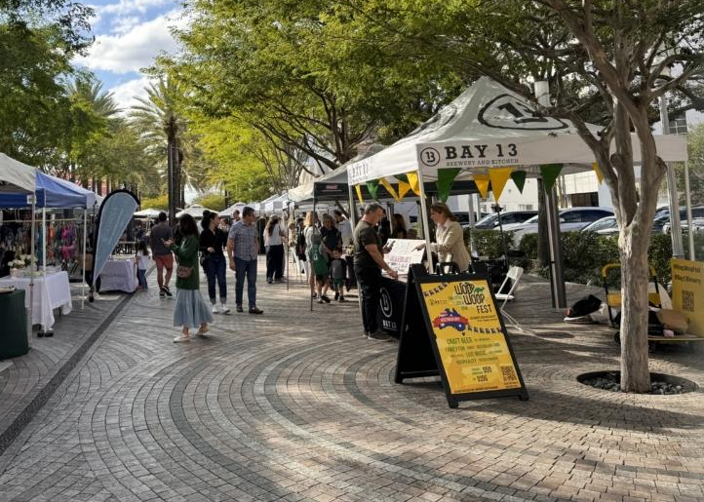
Green Improvements & Access to Open Spaces
Pedestrian Plaza and Green Market
Pedestrian Plaza: Giralda Avenue

Slide 30
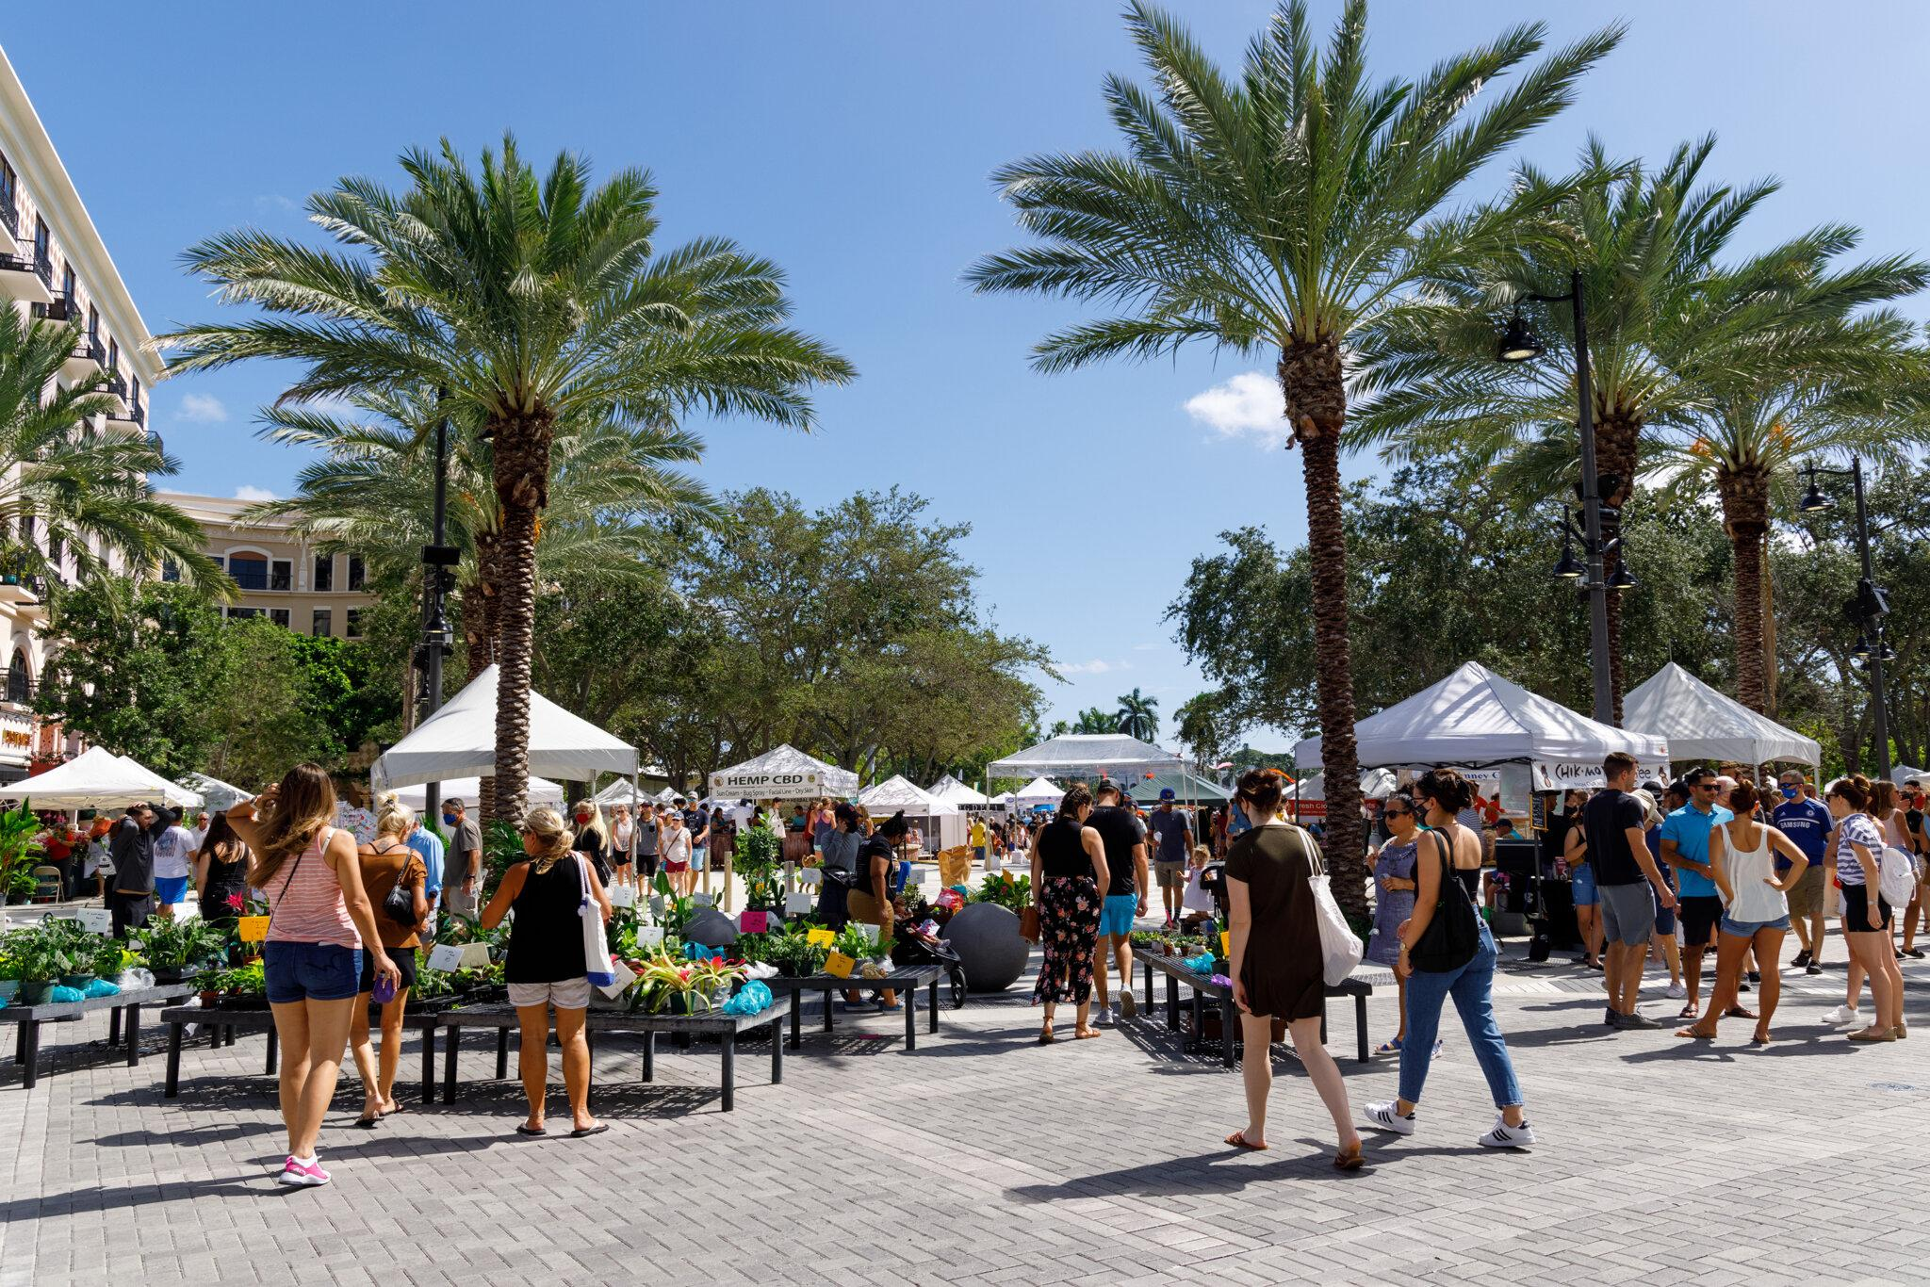
Green Improvements & Access to Open Spaces
Pedestrian Plaza and Green Market
Farmer’s Market: West Palm Beach, Florida

Slide 31
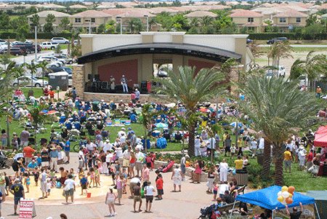
Green Improvements & Access to Open Spaces
Events Pavilion
Public Amphitheater: Canyon Amphitheater, Boynton Beach, Florida

Slide 32
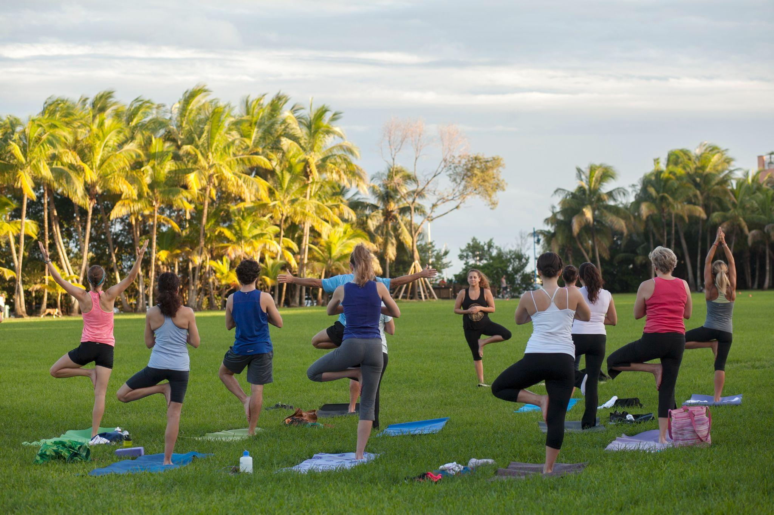
Green Improvements & Access to Open Spaces
Outdoor Dining
Walking Paths and Open Flexible Lawn Space, Peacock Park, Miami, Florida

Slide 33
Green Improvements & Access to Open Spaces
FUNDING
City of Greenacres Capital Projects Funds: A capital project to fund the community center and public park expansion could be proposed for a future fiscal year budget using a combination of sources including the general fund, grant dollars, impact fees, and bond proceeds.
Grants: There are several grants available to support public space and parks initiatives such as the following; Florida Recreation Development Assistance Program, Florida Department of Economic Development. This competitive, reimbursement grant program provides financial assistance for acquisition or development of land for public outdoor recreation. https://floridadep.gov/lands/land-and-recreation-grants/content/florida-recreation-development-assistance-program
City of Greenacres Capital Projects Funds: A capital project to fund the community center and public park expansion could be proposed for a future fiscal year budget using a combination of sources including the general fund, grant dollars, impact fees, and bond proceeds.
Levitt Foundation: Levitt Foundation offers grants, resources, and support to build and sustain signature Levitt music venues and to present the Levitt AMP series.
https://levitt.org/
Public Private Partnership (P3): Explore the possibility of partnering with a private entity to develop an amphitheater in the community park.
Recommendations
Transform Swain Boulevard into a vibrant, walkable, downtown, with sense of identity unique to Greenacres
Initial investments by the City of Greenacres
  Redevelop community center
  Streetscape improvements
  Redevelop commercial buildings
  Provide placemaking
Private sector investment to follow
  Unify and simplify zoning districts around Swain
  Update zoning language to allow low-density walkable developments (townhomes, retail, live/work mixed-use)

Slide 34
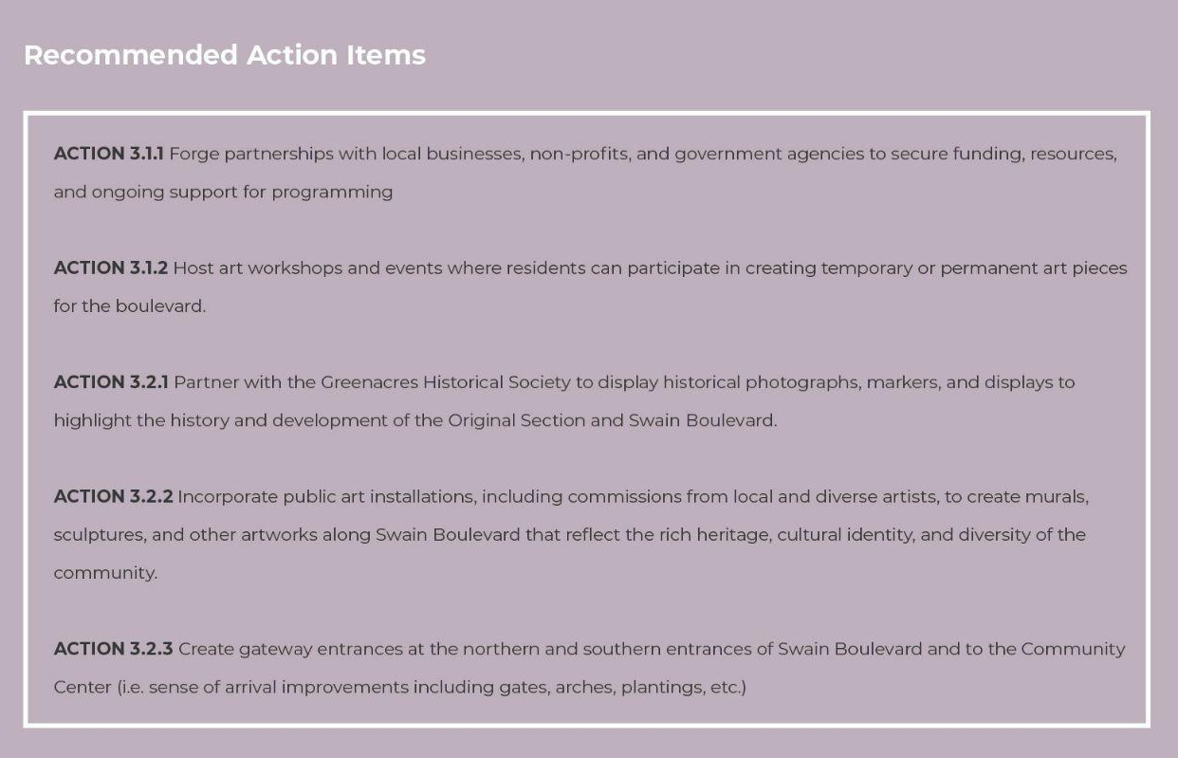
Placemaking & Art in Public Places
4
Recommendations
Transform Swain Boulevard into a vibrant, walkable, downtown, with sense of identity unique to Greenacres
Initial investments by the City of Greenacres
  Redevelop community center
  Streetscape improvements
  Redevelop commercial buildings
  Provide placemaking
Private sector investment to follow
  Unify and simplify zoning districts around Swain
  Update zoning language to allow low-density walkable developments (townhomes, retail, live/work mixed-use)

Slide 35
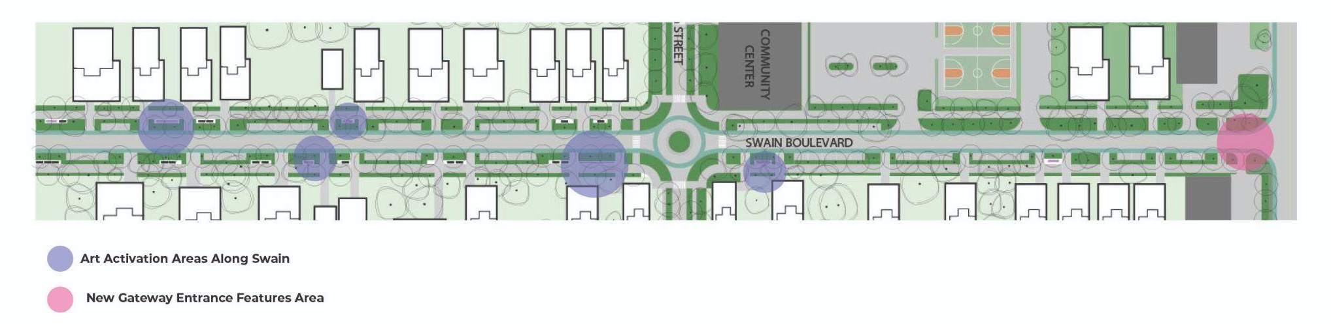
Placemaking & Art in Public Places
Create a sense of place to be in, not drive through where people want to invest and be
Flexible community gathering spaces to include a centralized pedestrian plaza and and outdoor amphitheatre for large events and programming opportunities such as markets, local vendor days, and job and job training fairs
Art in public places for installations and cultural expression
Programming to allow for local business participation
Recommendations
Transform Swain Boulevard into a vibrant, walkable, downtown, with sense of identity unique to Greenacres
Initial investments by the City of Greenacres
  Redevelop community center
  Streetscape improvements
  Redevelop commercial buildings
  Provide placemaking
Private sector investment to follow
  Unify and simplify zoning districts around Swain
  Update zoning language to allow low-density walkable developments (townhomes, retail, live/work mixed-use)

Slide 36
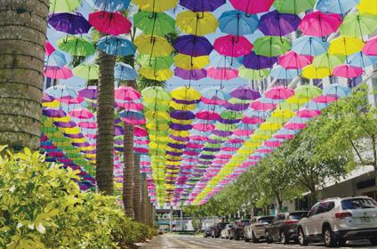
Placemaking & Art in Public Places
Integrated Strategic Art in Public Places
Umbrellas over CityPlace Doral

Slide 37
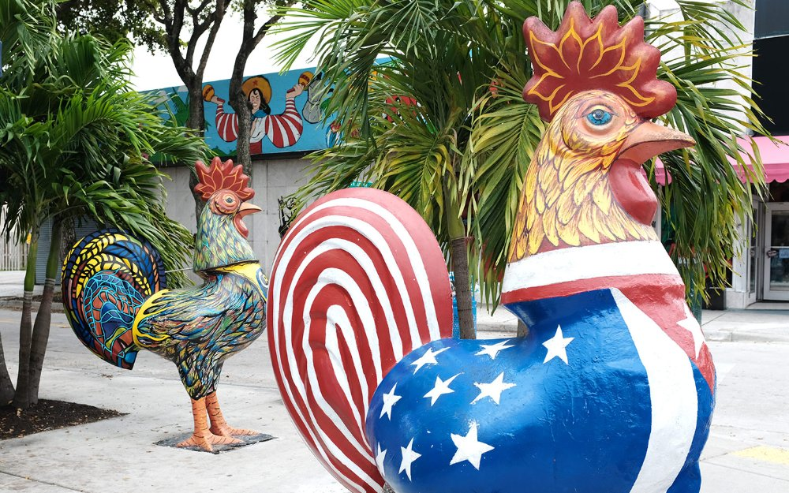
Placemaking & Art in Public Places
Integrated Strategic Art in Public Places
Calle Ocho, Little Havana, Miami, Florida

Slide 38
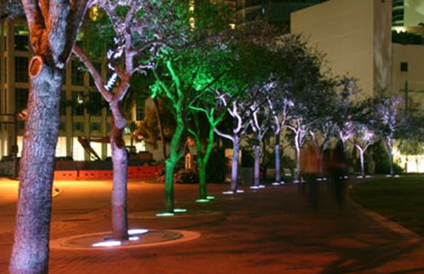
Placemaking & Art in Public Places
Integrated Strategic Art in Public Places
The Broward Lighting Project

Slide 39
Placemaking & Art in Public Places
FUNDING
In implementing a mixed-use code update to apply to development nodes in the identified strategic areas throughout the City, it creates additional opportunities for new developments to pay into the Art in Public Places fund. With additional contributions, the city can capitalize on placement of art and enhancement of community assets using this fund.
There are grant opportunities available for placemaking initiatives including the following:
Community Placemaking Grants, Project for Public Spaces
Our Town, National Endowment for the Arts
Recommendations
Transform Swain Boulevard into a vibrant, walkable, downtown, with sense of identity unique to Greenacres
Initial investments by the City of Greenacres
  Redevelop community center
  Streetscape improvements
  Redevelop commercial buildings
  Provide placemaking
Private sector investment to follow
  Unify and simplify zoning districts around Swain
  Update zoning language to allow low-density walkable developments (townhomes, retail, live/work mixed-use)

Slide 40
Summary of Focus Area Recommendations
Mixed-Use & Commercial Property Opportunities
Transportation & Infrastructure Improvements
Green Improvements & Access to Open Spaces
Placemaking &
Art in Public Places
IDEA 1.1 Acquisition of additional properties along Swain Boulevard and rehabilitation of existing buildings for growth opportunities.
IDEA 1.2 Update zoning ordinance and creation of illustrative form based design guidelines to combine existing mixed-use zoning districts for Swain Boulevard and 10th Avenue North to increase urban density, maximum heights, and provide expanded uses along Swain Boulevard and 10th Avenue North.
IDEA 2.1 Continue to improve road infrastructure along Swain Boulevard to include on-street parking, wide pedestrian paths, and bike lanes.
IDEA 2.2 Leverage existing City-owned transit and infrastructure to improve the streetscape for a more pedestrian-friendly and inviting Swain Boulevard. Using wayfinding signage can help residents and guests navigate the area, especially ahead of major local events.
IDEA 3.1 Develop the existing Community Center and Irva Van Bullock Park as a cohesive master planned area to serve as a new hub connected to Swain Boulevard with community benefit opportunities such as educational programming, public outdoor recreation and recreational amenities, markets, local vendor days, art and cultural installations, and job training fairs.
IDEA 3.2 Integrate native planting, enhance tree canopy (as a designated Tree City), and sustainability learning programs through street markets in a newly created plaza space.
IDEA 4.1 Programming to allow for public private partnerships to create a sense of place and educational events for residents and visitors to enjoy at all times.
IDEA 4.2 Encourage installation of community markers including public art, cultural and historical signage, and gateway elements that identify specific locations of interest.
Recommendations
Transform Swain Boulevard into a vibrant, walkable, downtown, with sense of identity unique to Greenacres
Initial investments by the City of Greenacres
  Redevelop community center
  Streetscape improvements
  Redevelop commercial buildings
  Provide placemaking
Private sector investment to follow
  Unify and simplify zoning districts around Swain
  Update zoning language to allow low-density walkable developments (townhomes, retail, live/work mixed-use)

Slide 41
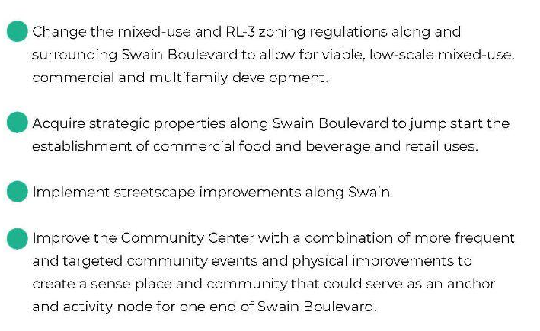
Summary of Focus Area Recommendations
It is envisioned that improvements contained within this report will make Greenacres not only a “Good Place to Live” but a “Great Place For All.”
Mixed-Use & Commercial Property Opportunities
Activate existing commercial buildings
Change zoning to encourage
mixed-use development
Streetscape transformation
Public gathering spaces
Art in public spaces program(s)
Community event programming
Transportation & Infrastructure Improvements
Placemaking &
Art in Public Places
Green Improvements & Access to Open Spaces
Recommendations
Transform Swain Boulevard into a vibrant, walkable, downtown, with sense of identity unique to Greenacres
Initial investments by the City of Greenacres
  Redevelop community center
  Streetscape improvements
  Redevelop commercial buildings
  Provide placemaking
Private sector investment to follow
  Unify and simplify zoning districts around Swain
  Update zoning language to allow low-density walkable developments (townhomes, retail, live/work mixed-use)

Slide 42



THANK YOU!
Prepared for the City of Greenacres
Mayor and City Council:
Charles (Chuck) Shaw, Mayor
John Tharp, Councilmember, District I
Peter A. Noble, Councilmember, District II
Judith Dugo, Deputy Mayor, District III
Susy Diaz, Councilmember, District IV
Paula Bousquet, Councilmember, District V
Administration:
Andrea McCue, City Manager
Christy Goddeau, City Attorney
Glen J. Torcivia, City Attorney
Tanya Earley, City Attorney
Quintella Moorer, City Clerk
Leadership Project (LP) by
The Urban Land Institute (ULI Southeast Florida/Caribbean) Leadership Institute
2024 Leadership Institute Project Team:
Matthew Barnes, AICP, Senior Project Manager, WGI
Gina Chiello, WEDG, Senior Director, Cummins Cederberg Inc.
Maria Debye Saxinger, ASLA, Master Plan Manager, Miami-Dade Parks
Grég Gabriel, Regional Director of Acquisition & Development, Pinnacle
Trisha Logan, AICP, Principal Urban Planner, City of Fort Lauderdale
David Rendina, Chief Strategy Officer, Rendina Real Estate Development
Michael Trimble, Senior Director of Development, Ram Realty Advisors
Acknowledgements
Our Team would like to thank City staff including, Andrea McCue, City Manage; Gigi Chazu, Director of Economic Development; Denise Malene, Director of Development and Neighborhood Services; and Gionni Gallier, Senior Planner for supporting project information, insight and collaboration.
We would also like to thank ULI for the opportunity to participate in the 2024 Leadership Institute Program and our advisor Rafael Romeo, for his valuable guidance; and our respective employers for their support.
Thank you to our 2024 Sponsors:

