Slide 1


Slide 2



Emerging Trends in Real Estate®
Global Outlook for 2022

Slide 3




Emerging Trends® in Real Estate Global Outlook 2022
Moderator
Mike Philips
UK Editor, Bisnow
Presenter
Gareth Lewis
Director,
PricewaterhouseCoopers LLP
@UrbanLandInst
ULIGlobal
Notes:
Mike introduces himself as moderator and covers the format of the session then hands to Gareth
Welcome to the launch GETRE 2022. I’m GL. Thanks to ULI, participants
GETRE draws together insights from 3 regional reports in combo with an additional 25 interviews with global leaders.
What's the outlook for the year ahead?
A combination of positivity alongside uncertainty was evident from the almost 3.5k surveys who took part in the regional surveys & the additional interviews conducted 4 this Global Emerging Trends edition. (very similar to 2 years ago at the start of the global pandemic)
Just as everyone dared to hope that the pandemic is receding, Russia’s invasion of Ukraine has set off a new wave of apprehension across the world & fears of a wider conflict.

Slide 4
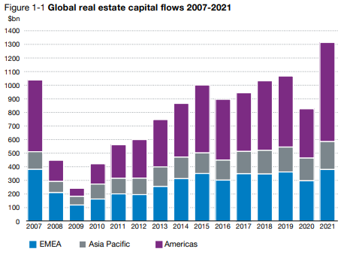
Setting the scene
“
If [logistics] supply increases a lot more, then there is a risk that those tight cap rates are not accompanied with big rental growth in the future
“
Notes:
First set the scene
In ‘21, Global volumes for sales of commercial RE totalled more than $1.3 trillion, 59% higher than the 2020 total & 22% ahead of the previous peak in ‘19, according to RCA. This extraordinary level of activity was driven by worldwide demand for residential & industrial property & in particular a dramatic upturn in the US transactions.
A key factor was the premium between property yields & interest rates, which remains in place across most global markets. This positive capital markets perspective for RE just about holds good — for the time being. But the uncertainty will inevitably slow the deal-making down, especially in Europe

Slide 5
The immediate challenge: Russia’s invasion of Ukraine
Far greater geopolitical risk and slow global growth
Government spending my change, particularly in Europe
Unlikely to lead to world recession
A major jolt to the real estate industry
What impact will the problem of energy security have?
And higher and longer-lasting inflation
Bigger questions around the ESG agenda
Notes:
The first thing to be addressed is the Russian invasion of Ukraine. Begin by acknowledging the humanitarian tragedy which is unfolding across the region.
What does it mean for RE?
If there is a consensus among economists, it is that the Ukraine conflict is unlikely to lead to world recession although noone ruling out that outcome
At the very least, however, the effect of the Russian invasion of Ukraine is expected to be a far greater geopolitical risk alongside slower global growth
And critically higher & longer-lasting inflation
Even that relatively benign macro scenario this year would serve as a major jolt to the RE industry, particularly compared to ‘21 as discussed on previous slide
It is possible that the industry in Europe may have to deal with the consequences of very swift changes in government spending in favour of defence & energy policies & away from the areas that directly affect RE, such as infrastructure and housing.
Yet the invasion of Ukraine also poses bigger questions around the ESG agenda and in particular the impact the acute problems of energy security will have on the ESG agenda in the longer term?

Slide 6
Inflationary pressure
“
I do think that real assets are better positioned than fixed income, especially, to handle inflation
“
Notes:
Looking at inflationary pressure… In Jan, inflation in Europe hit 5.1% & in the US 7.5%, which is the fastest annual rise there for 40 years.
The full impact on RE of labour shortages, rising wages & food bills & surging energy costs remains unclear. Yet the prevailing view among many in the industry, & many economists, is of moderating economic growth, inflation peaking this year – see chart.
This has understandably fed through to concerns about construction, material & labour costs in North America & Europe. These were the top ranked concerns coming out of the Emerging Trends regional reports – even before the Ukraine crisis.
Whilst inflation appears to be less of a concern in Asia Pacific than the other regions, even there it adds to the development challenge.
But, with big caveats over development & huge uncertainty due to the invasion of Ukraine, most interviewees still hang on to the traditional view of RE as a good inflation hedge generally.

Slide 7
Logistics
Huge demand
Disrupted supply chains
Yields converging
But…
Late cycle pricing
A question over future rental growth
Retail
Declining investment volumes
The real estate “pariah”
But…
Value opportunities arising
The purpose of physical retail is clear
Experience driven
Office
Work from home caused disruptions
No clear direction
But…
Geographical differences Asia – less impact
US – longer term impact?
Location and spec are key
Residential
Largest sector in 2021
Favourable supply-demand dynamics
But…
There are concerns around housing affordability
Notes:
Heres a quick look at the key points from around the global on the 4 main RE sectors
Logistics: With a build-up of capital that favours RE over other asset classes, logistics remains the main draw, alongside residential.
Even last year there was some “hesitancy around pricing” on logistics. One year on, logistics has come to epitomise the potential risks & rewards of RE investment — a sort of lightning rod for bullish and bearish comment about the asset class as a whole. But there are concerns voiced around late cycle pricing, rental growth & a number of interviewees cited the fact that Logistics on the development side is more exposed to inﬂation than other sectors just because of the nature of the product.
Retail: Declining investment volumes – the RE pariah asset class. But we also heard talk of retail being oversold, & growing reference to the number of opportunities within these sectors presented by an “uneven recovery”
Office: Similar theme for offices – opportunities. No clear consensus on the longterm impact of WFH (dispersed workforce). Certainly geographical differences. Eg WFH less impact in Asia. In Seoul, for instance, office investment in 2021 was well ahead of previous years, according to RCA.
Residential: For investors, the flipside of widespread affordability problem has been the continued reallocation of capital from unfavoured sectors into various forms of housing. & again, the growing attraction of residential has been reflected in Emerging Trends’ North American & European editions over several years.
.

Slide 8
Beyond the mainstream
Alternative sectors are gaining popularity as part of a fundamental shift into more operational and service-based real estate
“
The industry is buying into the new generation, new economy sectors where the underlying business growth is coming from digitization, wellness or healthcare, because those are just
tenants that are growing
“
“
Anything where you can add a service component can be quite helpful in terms of an inflationary environment because you can increase the price of your service, or you have the optionality to do it
“
Notes:
Beyond the mainstream sectors, Alternative RE sectors are gaining popularity as part of a fundamental shift into more operational & service-based RE
In particular, this applies to sectors where the underlying business growth is coming from digitization, wellness or healthcare & asset classes you can add a service component
Operational RE has won wide & growing support across the industry, also partly because it is contra-cyclical & more of an inflation hedge than mainstream sectors. It remains to be seen whether demand for such assets will become even stronger during the economic fall-out from Russia-Ukraine.

Slide 9
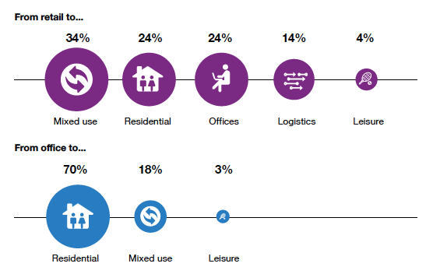
Repurposing is gathering pace
In Europe, 52% of respondents increased the number of assets they repurposed last the previous
The most common building type repurposed last year
From retail to…
Mixed use Residential Offices Logistics Leisure
From office to…
Residential Mixed use Leisure
Source: Emerging Trends in Real Estate Europe 2022
Notes:
But there are some common themes across all RE sectors
The industry is already paying far closer attention to detail in asset management and the due diligence undertaken on the acquisition of any property type will be more rigorous than ever.
Another common theme: Repurposing is gathering pace.
Despite overall resilience, some sectors & markets have experienced upheaval, leaving many assets obsolete & needing to be repurposed — a theme that to varying degrees runs through all three regional reports (Europe, Asia & North America)
In Europe, 52% of respondents increased the number of assets they repurposed compared to previous years
Most commonly from Retail to Mixed use or from office to residential.
The need for repurposing many assets does not go away, but the clear message back from our research is that repurposing is a much more complex & challenging proposition than many would give it credit for.

Slide 10
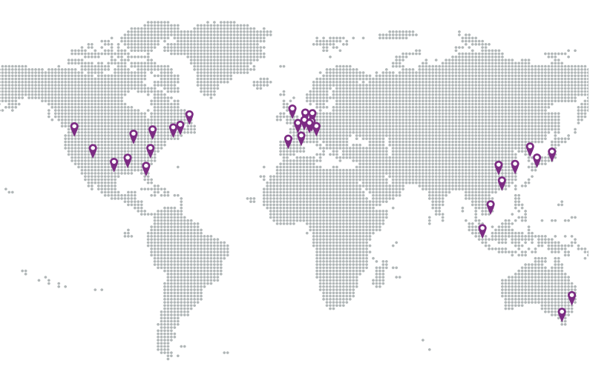
US
Nashville
Raleigh-Durham
Phoenix
Austin
Tampa/St. Petersburg
Charlotte
Dallas/Fort Worth
Atlanta
Seattle
Boston
Asia Pacific
Tokyo
Singapore
Sydney
Melbourne
Seoul
Osaka
Shanghai
Ho Chi Minh City
Shenzhen
Guangzhou
Europe
London
Berlin
Paris
Frankfurt
Munich
Madrid
Amsterdam
Hamburg
Barcelona
Brussels
Source: Emerging Trends in Real Estate Global 2022
Notes:
What about the investment prospect for global cities?
Big cities still find favour with the industry leaders interviewed for the Europe & Asia Pacific report, reflecting a preference for the safe & the familiar as well as the adaptability of these markets to structural changes in society.
Against the backdrop of economic uncertainty following the pandemic, it is little surprise that London, Berlin & Paris are seen as the best investment prospects in Europe, and that Tokyo, Singapore and Sydney lead the rankings in Asia Pacific.
It is noteworthy that London now tops the European rankings despite being perceived to have suffered in the immediate backlash against big cities & long commutes during the worst of the pandemic in 2020.
These major, denser cities are seen to be “much more resilient to the working-from-home trend”
The narrative around city growth is arguably more nuanced in Emerging Trends US & Canada, which identifies “a more suburban future”, particularly in the Sun Belt region cities.
I’ve certainly hear many speculate that the larger US cities are less well equipped to bounce back from the WFH trend (& the rejection of the long commute) because the cities are generally more car centric & less well equipped than the European cities (that have evolved over centuries) to be more aligned with the growing importance of walkability – and such concepts as the “15 minute city” .

Slide 11
Has the potential to enable real estate to play its part in decarbonising
Calls for $7tr to be invested annually until 2030 to tackle climate change
Equity investors - leading the charge & working to get ahead of regulation
Lack of alignment hinders ability to demand improvement
Equity + debt provider have power to influence the industry’s approach
Work is needed to harmonise the definition of “zero carbon”
Debt providers, with notable exceptions - waiting for regulation
Notes:
Before I hand over to the panel…touch on the other major agenda item for the industry - the ESG agenda
As we explore in Chapter 2 of this years report, there has been a huge reallocation of capital towards decarbonising RE— but also so much more to be done by lenders & regulators if the industry is to meet its targets.
The OECD calls for $7 trillion to be invested each year between now & 2030 for the world to meet climate & development objectives.
That reallocation has the potential to enable RE to play its part in decarbonising the world economy
Equity & debt providers - that drive RE & determine how it acts - have the power to influence the industry’s approach to issues like decarbonisation & social impact.
Indications are that it’s the equity investors that are leading the charge, & working to get ahead of regulation.
Whereas debt providers,with notable exceptions, seem to be waiting for regulation to come.
One of the biggest challenges is that the RE industry needs to come together to work with regulators to harmonise the definition of “zero carbon”, the way in which carbon emissions are measured & how green buildings are classified.
& a lack of agreement about the benchmark level of emissions from a building hinders the ability of a lender to demand an improvement.
But as already mentioned, there is now great uncertainty about whether the surging energy costs resulting from the Ukrainian crisis will speed up or undermine the global transition from fossil fuels to cleaner energy sources. The danger is that high prices will spur further investment in oil & gas production just as they did in previous crises. For the longer term, the hope is that acute problems of energy security will act as a wake-up call to governments about the radical economic transformation they need to implement under the ESG agenda

Slide 12



Emerging Trends® in Real Estate Global Outlook 2022
Lisette Van Doorn
Chief Executive Officer, Europe, Urban Land Institute
Michèle Hubert
Chief Operating Officer, Ivanhoé Cambridge Inc.
Christina Gaw
Managing Principle, Gaw Capital
@UrbanLandInst
ULIGlobal

Slide 13

We value your feedback and would appreciate if could take a minute to complete the Zoom survey before you leave.
Please give us any other feedback, questions or suggestions for other topics by emailing europe.events@uli.org
Thank you

Slide 14

ULI Spring Meeting 2022
Where ULI members come together to
shape the built environment
ULI Europe Conference 2022
April 19 - 21, 2022
San Diego, California + Digital
www.spring.uli.org
Connect with the world of real estate
May 11 - 13, 2022
Brussels, Belgium + Digital
www.europeconference.uli.org

Slide 15


